Slide 1
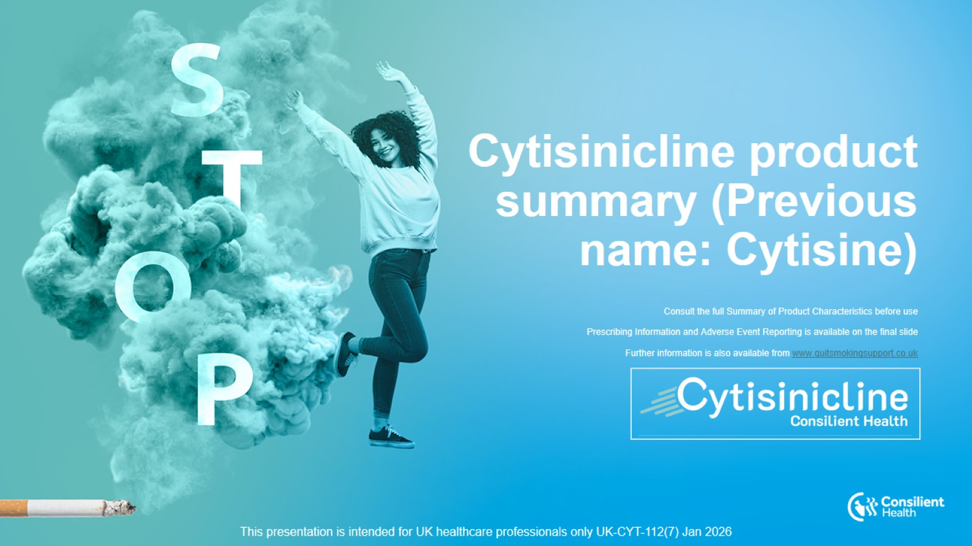
Cytisinicline product summary (Previous name: Cytisine)

Slide 2
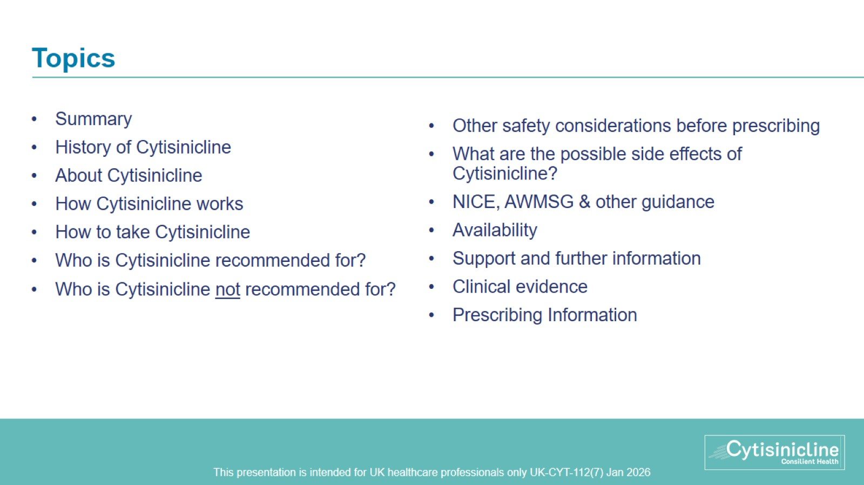
Topics

Slide 3
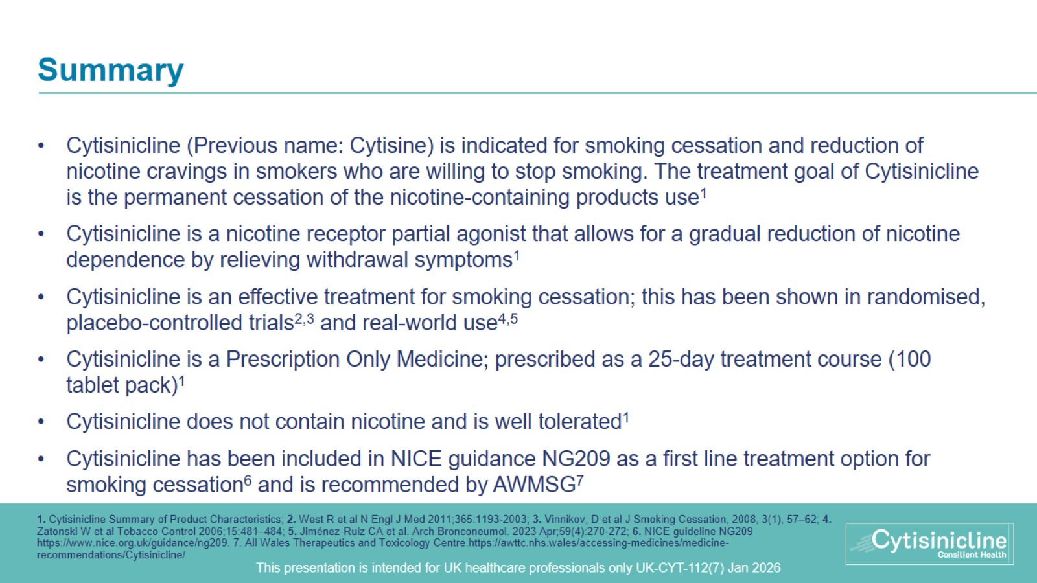
Summary

Slide 4
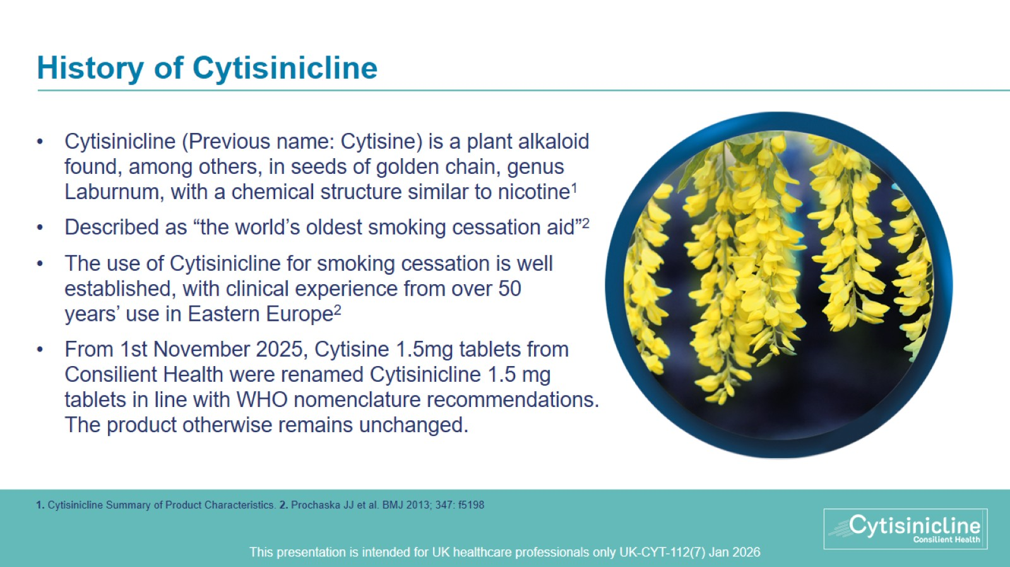
History of Cytisinicline

Slide 5
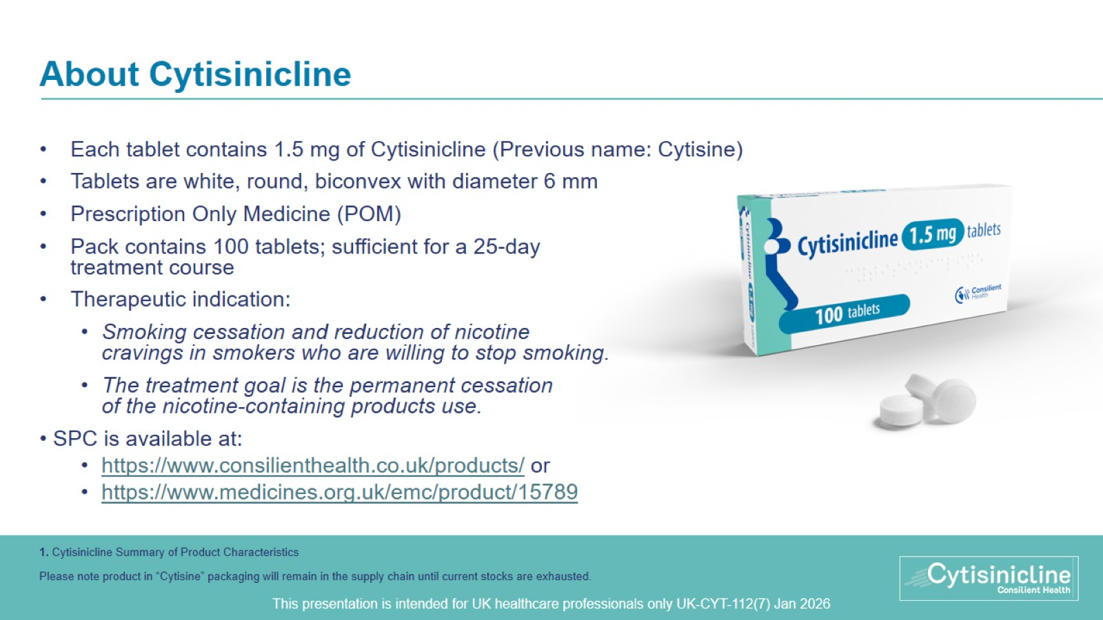
About Cytisinicline
Notes:
1 NAME OF THE MEDICINAL PRODUCT
Cytisinicline 1.5 mg tablets (Previously used name: Cytisine)
2 QUALITATIVE AND QUANTITATIVE COMPOSITION
Each tablet contains 1.5 mg of Cytisinicline.
For the full list of excipients, see section 6.1.
3 PHARMACEUTICAL form
Tablet
Round, biconvex, white tablet with diameter 6 mm.
4 CLINICAL PARTICULARS
4.1 Therapeutic indications
Smoking cessation and reduction of nicotine cravings in smokers who are willing to stop smoking. The treatment goal of Cytisinicline is the permanent cessation of the nicotine‑containing products use.
4.2 Posology and method of administration
Posology
One package of Cytisinicline (100 tablets) is sufficient for a complete treatment course.
The duration of therapy is 25 days.

Slide 6
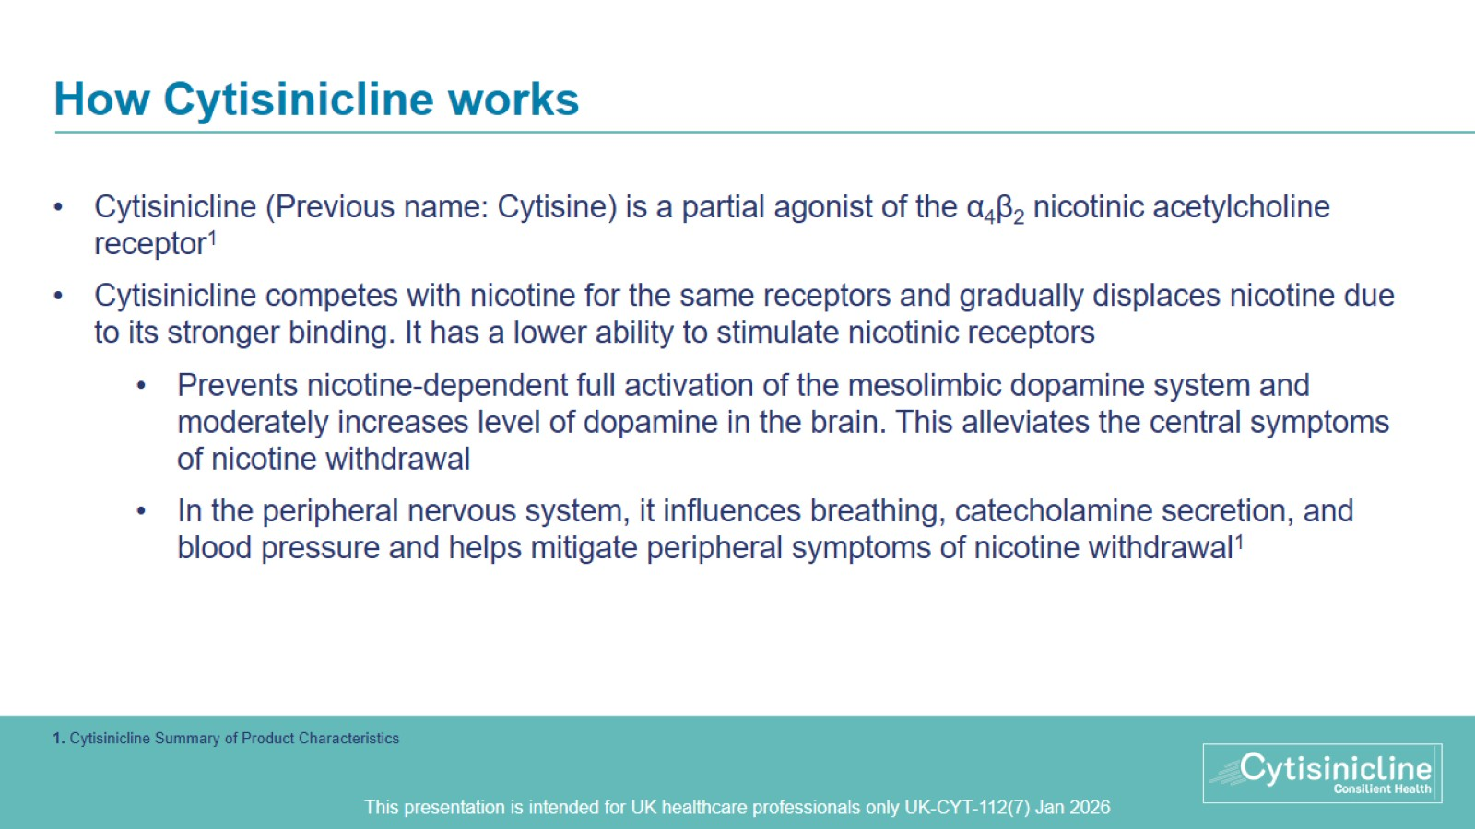
How Cytisinicline works
Notes:
5.1 Pharmacodynamic properties
Pharmacotherapeutic group: drugs used in nicotine dependence, ATC code: N07BA04
The use of Cytisinicline allows for a gradual reduction of nicotine dependence by relieving withdrawal symptoms.
The active ingredient of Cytisinicline is a plant alkaloid Cytisinicline (found, among others, in seeds of golden chain, genus Laburnum), with a chemical structure similar to nicotine. It has an effect on acetylcholine nicotinic receptors. The action of Cytisinicline is similar to that of nicotine, but in general weaker. Cytisinicline competes with nicotine for the same receptors and gradually displaces nicotine due to its stronger binding. It has lower ability to stimulate nicotinic receptors, mainly α4β2 subtype (it is their partial agonist) and less than nicotine passes into the central nervous system. It is hypothesized that in the central nervous system Cytisinicline acts on the mechanism involved in nicotine dependence and on the release of neurotransmitters. It prevents nicotine dependent full activation of the mesolimbic dopamine system and moderately increases level of dopamine in the brain, what alleviates the central symptoms of nicotine withdrawal. In the peripheral nervous system, Cytisinicline stimulates and then affects the autonomic ganglia of the nervous system, causes a reflex stimulation of breathing and secretion of catecholamines from the core part of the adrenal gland, raises blood pressure and prevents peripheral symptoms of nicotine withdrawal.

Slide 7
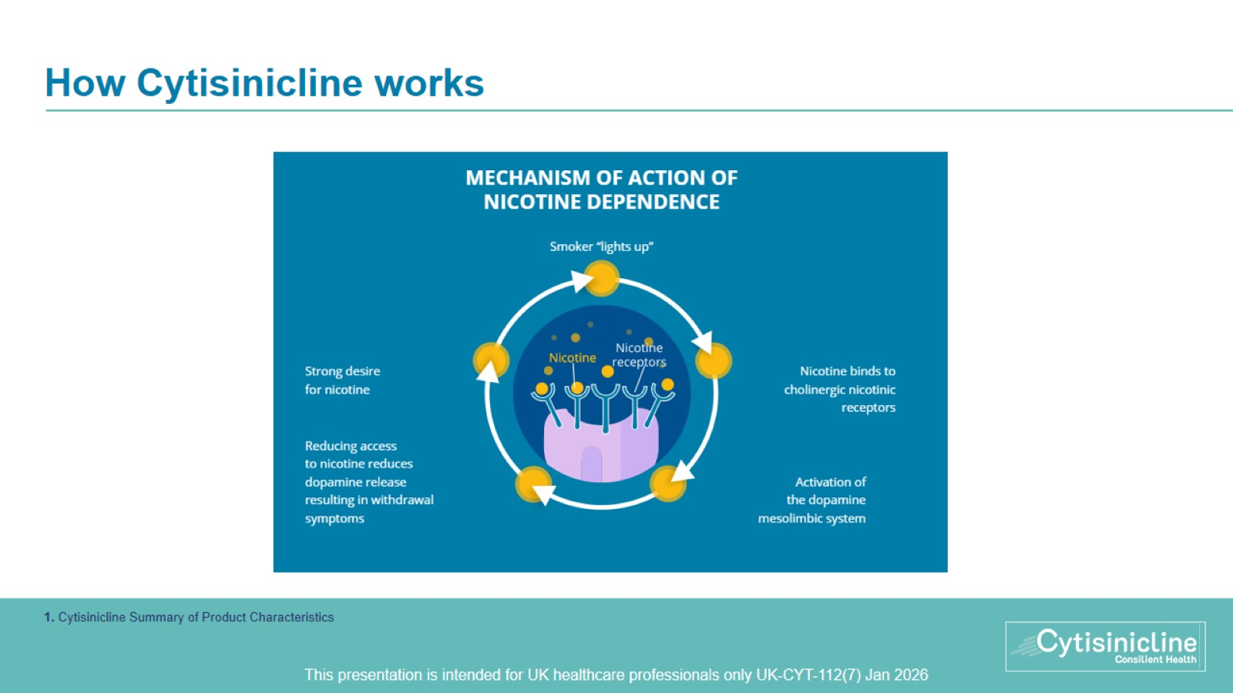
How Cytisinicline works

Slide 8
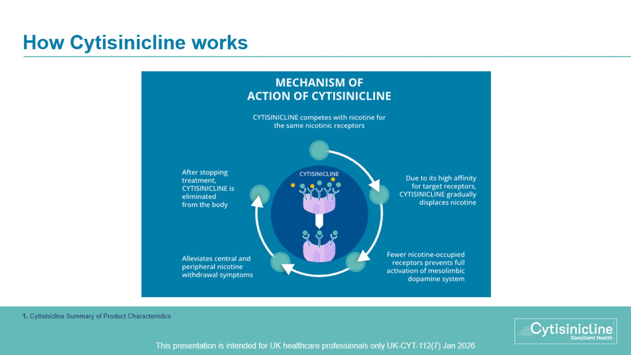
How Cytisinicline works

Slide 9
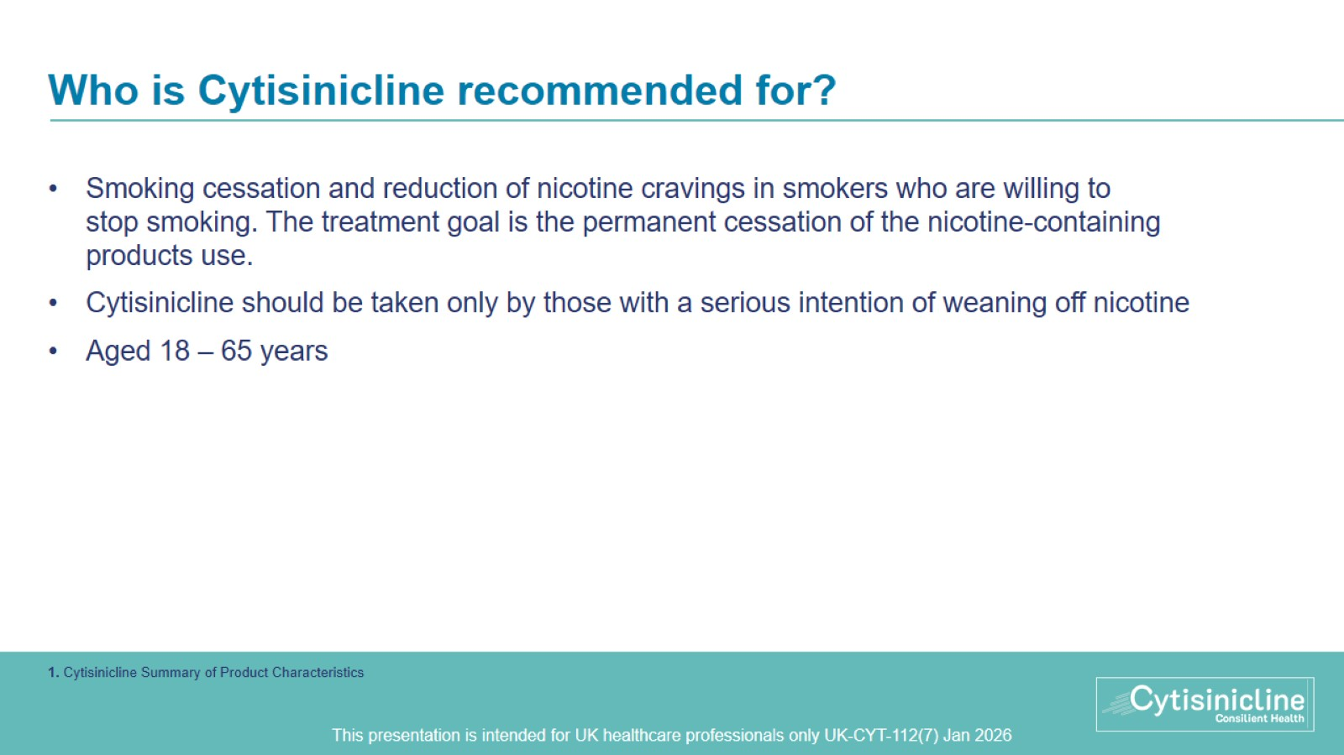
Who is Cytisinicline recommended for?

Slide 10
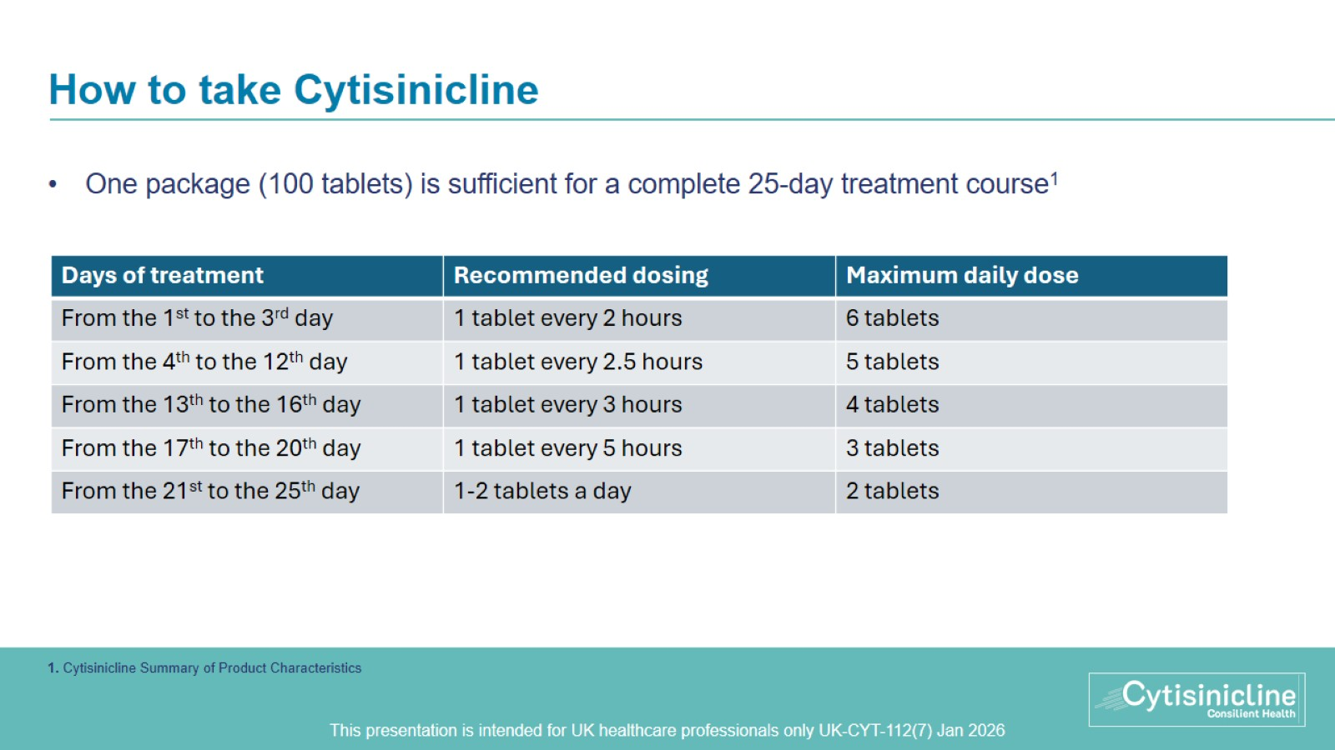
How to take Cytisinicline
Notes:
4.2 Posology and method of administration
Posology
One package of Cytisinicline (100 tablets) is sufficient for a complete treatment course.
The duration of therapy is 25 days.
Cytisinicline should be taken according to the following schedule:
Days of treatment Recommended dosing Maximum daily dose
From the 1st to the 3rd day 1 tablet every 2 hours 6 tablets
From the 4th to the 12th day 1 tablet every 2.5 hours 5 tablets
From the 13th to the 16th day 1 tablet every 3 hours 4 tablets
From the 17th to the 20th day 1 tablet every 5 hours 3 tablets
From the 21st to the 25th day 1-2 tablets a day to 2 tablets
Smoking should be stopped no later than on the 5th day of treatment. Smoking should not be continued during treatment as this may aggravate adverse reactions (see section 4.4).
In case of treatment failure, the treatment should be discontinued and may be resumed after 2 to 3 months.
Method of administration
Cytisinicline should be taken orally with a suitable amount of water.

Slide 11
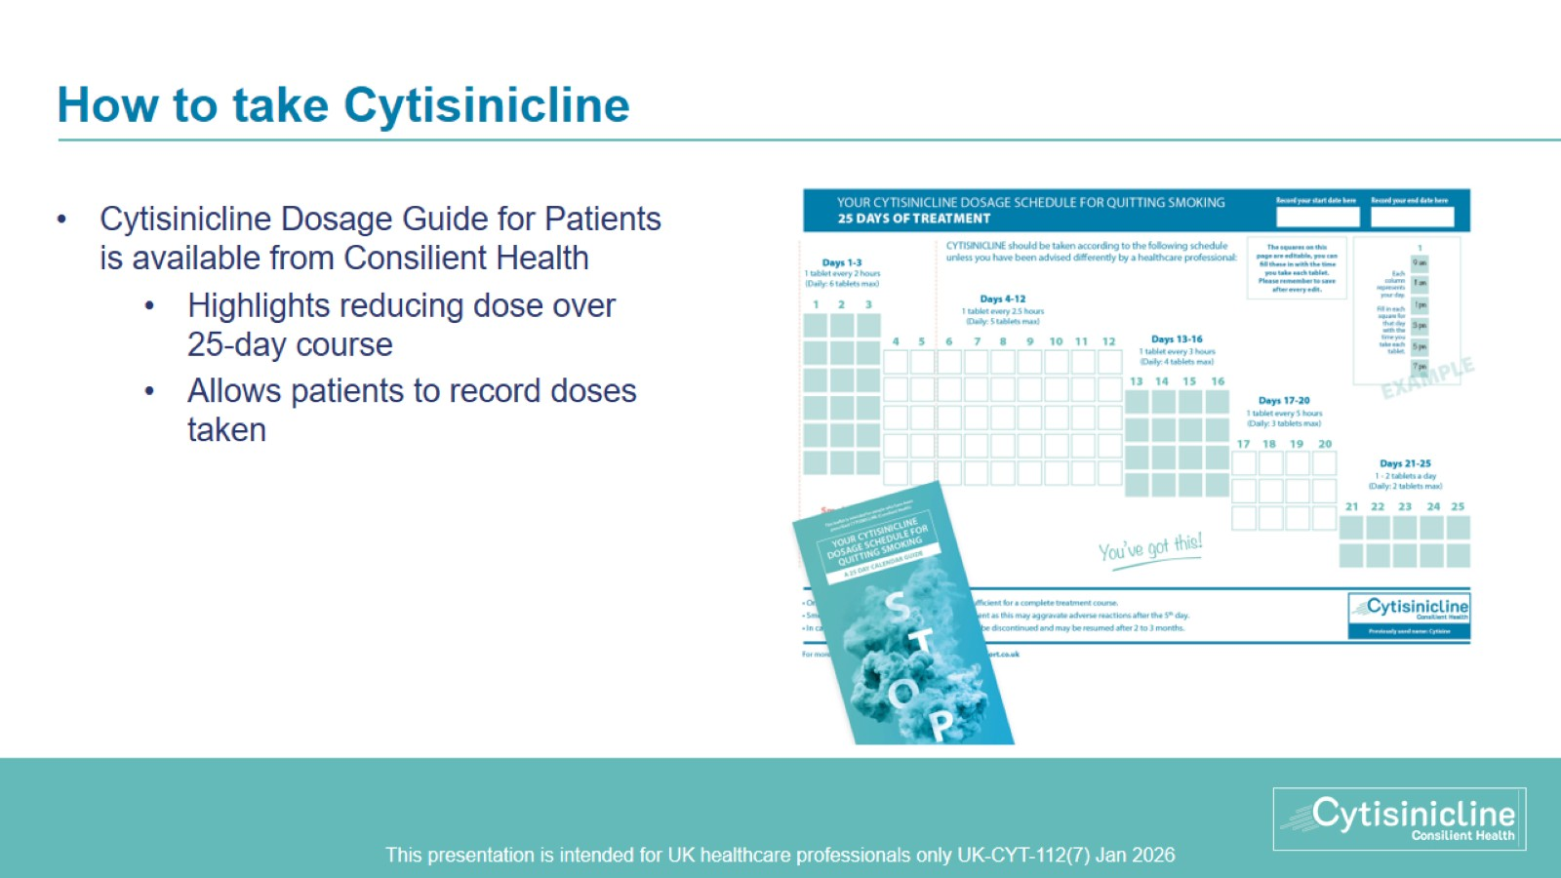
How to take Cytisinicline

Slide 12
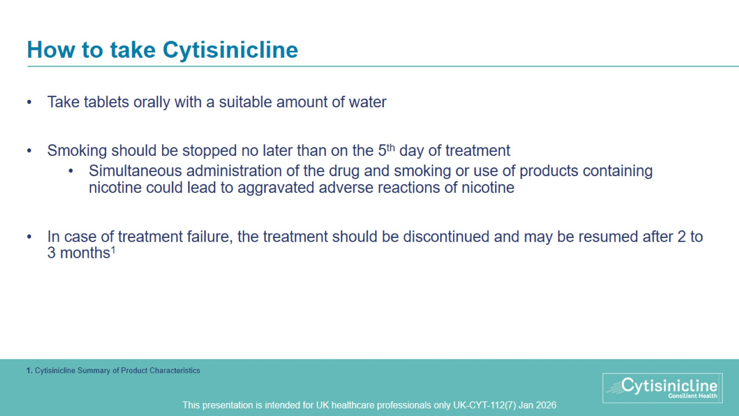
How to take Cytisinicline
Notes:
4.2 Posology and method of administration
Posology
One package of Cytisinicline (100 tablets) is sufficient for a complete treatment course.
The duration of therapy is 25 days.
Cytisinicline should be taken according to the following schedule:
Days of treatment Recommended dosing Maximum daily dose
From the 1st to the 3rd day 1 tablet every 2 hours 6 tablets
From the 4th to the 12th day 1 tablet every 2.5 hours 5 tablets
From the 13th to the 16th day 1 tablet every 3 hours 4 tablets
From the 17th to the 20th day 1 tablet every 5 hours 3 tablets
From the 21st to the 25th day 1-2 tablets a day to 2 tablets
Smoking should be stopped no later than on the 5th day of treatment. Smoking should not be continued during treatment as this may aggravate adverse reactions (see section 4.4).
In case of treatment failure, the treatment should be discontinued and may be resumed after 2 to 3 months.
Method of administration
Cytisinicline should be taken orally with a suitable amount of water.

Slide 13
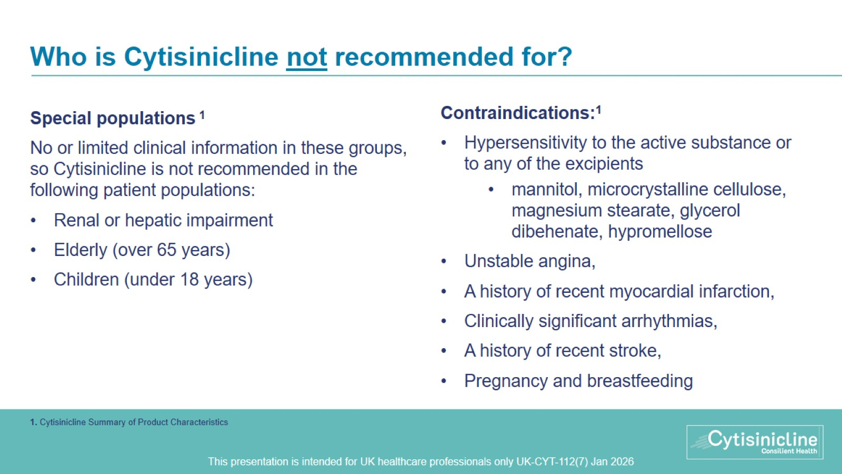
Who is Cytisinicline not recommended for?
Notes:
Special population (renal impairment, hepatic impairment)
There is no clinical experience of Cytisinicline in patients with renal or hepatic impairment, therefore the drug product is not recommended for use in this patient population.
Elderly population
Due to limited clinical experience, Cytisinicline is not recommended for use in elderly patients over 65 years of age.
Paediatric population
The safety and efficacy of Cytisinicline in persons under 18 years of age have not been established. Cytisinicline is not recommended for use in persons under 18 years of age.
4.3 Contraindications
Hypersensitivity to the active substance or to any of the excipients listed in section 6.1,
Unstable angina,
A history of recent myocardial infarction,
Clinically significant arrhythmias,
A history of recent stroke,
Pregnancy and breastfeeding.

Slide 14
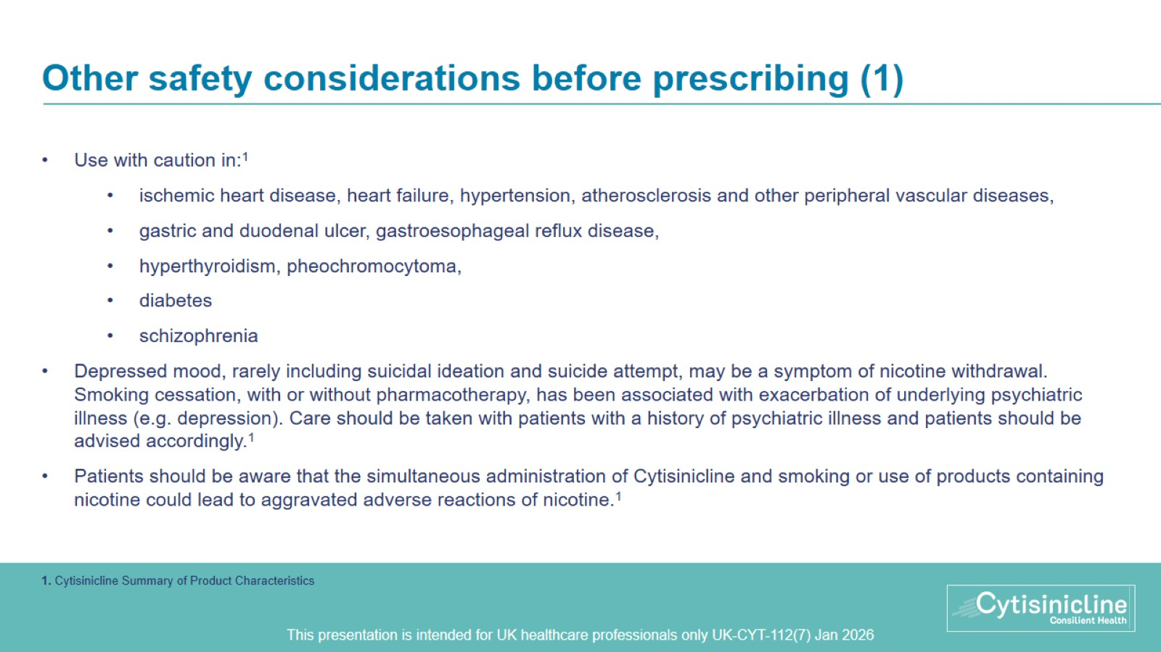
Other safety considerations before prescribing (1)
Notes:
4.4 Special warnings and precautions for use
Cytisinicline should be taken only by those with a serious intention of weaning off nicotine. Patient should be aware, that the simultaneous administration of the drug and smoking or use of products containing nicotine could lead to aggravated adverse reactions of nicotine.
Cytisinicline should be taken with caution in case of ischemic heart disease, heart failure, hypertension, pheochromocytoma, atherosclerosis and other peripheral vascular diseases, gastric and duodenal ulcer, gastroesophageal reflux disease, hyperthyroidism, diabetes and schizophrenia.
Stopping smoking: Polycyclic aromatic hydrocarbons in tobacco smoke induce the metabolism of drugs metabolised by CYP 1A2 (and possibly by CYP 1A1). When a smoker stops smoking, this may result in slower metabolism and a consequent rise in blood levels of such drugs. This is of potential clinical importance for products with a narrow therapeutic window, e.g. theophylline, tacrine, clozapine and ropinirole.
The plasma concentration of other medicinal products metabolised in part by CYP1A2 e.g. imipramine, olanzapine, clomipramine and fluvoxamine may also increase on cessation of smoking, although data to support this are lacking and the possible clinical significance of this effect for these drugs is unknown. Limited data indicate that the metabolism of flecainide and pentazocine may also be induced by smoking.
Depressed mood, rarely including suicidal ideation and suicide attempt, may be a symptom of nicotine withdrawal. Clinicians should be aware of the possible emergence of serious neuropsychiatric symptoms in patients attempting to quit smoking with or without treatment.
History of psychiatric disorders Smoking cessation, with or without pharmacotherapy, has been associated with exacerbation of underlying psychiatric illness (e.g. depression).
Care should be taken with patients with a history of psychiatric illness and patients should be advised accordingly.
Women of childbearing potential
Women of childbearing potential must use highly effective contraception while taking Cytisinicline (see section 4.5 and 4.6).
4.5 Interaction with other medicinal products and other forms of interaction
Cytisinicline should not be used with anti-tuberculosis drugs. No other clinical data on significant interaction with other drugs.
Patient should be aware, that the simultaneous administration of the drug and smoking or use of products containing nicotine could lead to aggravated adverse reactions of nicotine (see section 4.4).
Hormonal contraceptives
It is currently unknown whether Cytisinicline may reduce the effectiveness of systemically acting hormonal contraceptives, and therefore women using systemically acting hormonal contraceptives should add a second barrier method.

Slide 15
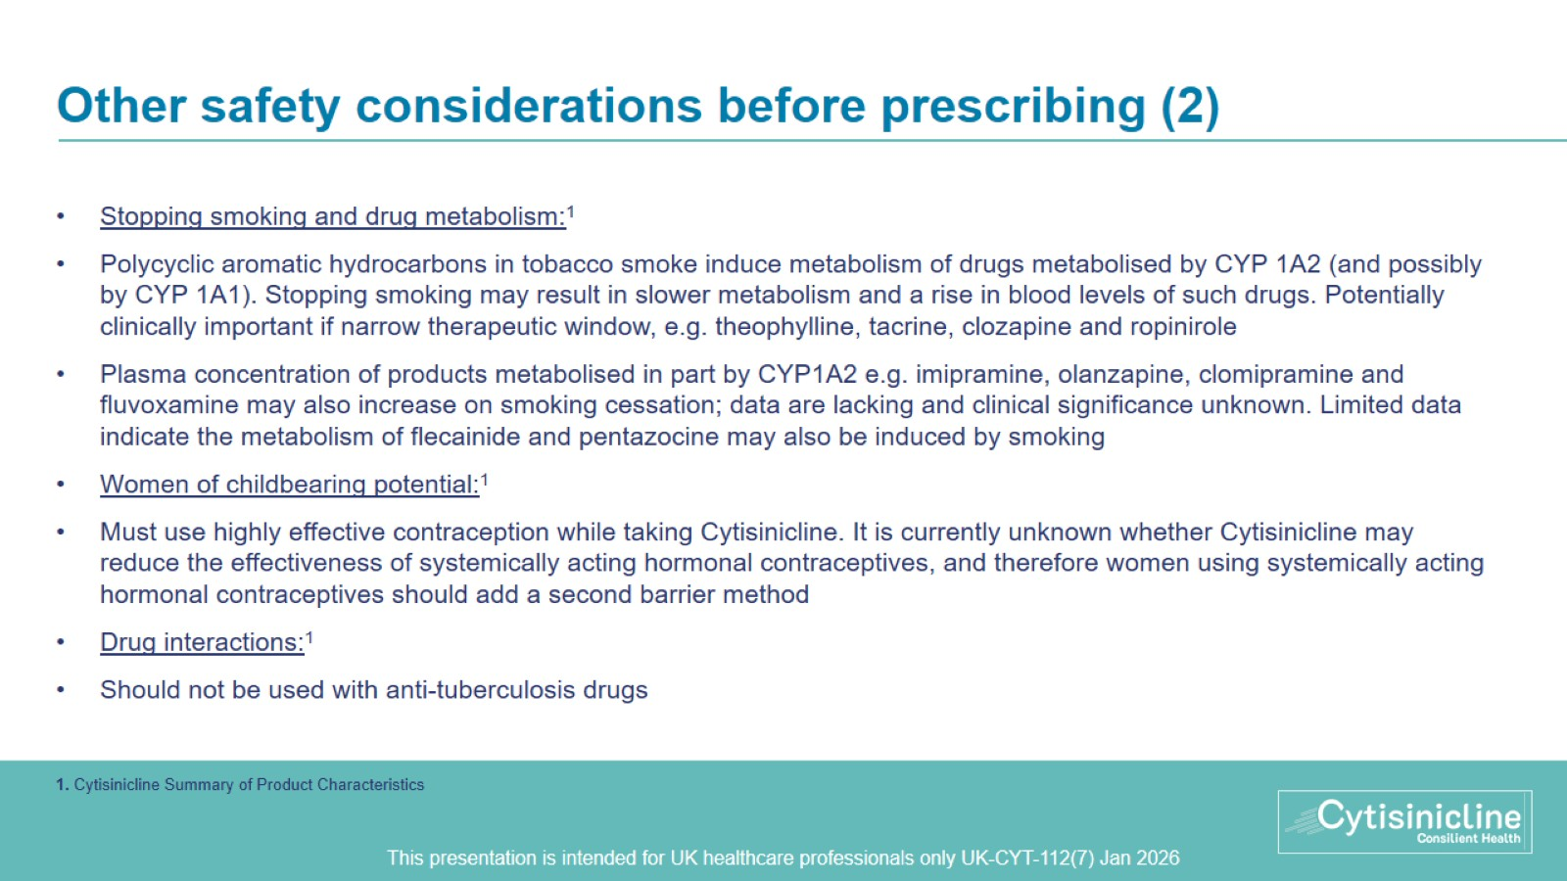
Other safety considerations before prescribing (2)
Notes:
4.4 Special warnings and precautions for use
Cytisinicline should be taken only by those with a serious intention of weaning off nicotine. Patient should be aware, that the simultaneous administration of the drug and smoking or use of products containing nicotine could lead to aggravated adverse reactions of nicotine.
Cytisinicline should be taken with caution in case of ischemic heart disease, heart failure, hypertension, pheochromocytoma, atherosclerosis and other peripheral vascular diseases, gastric and duodenal ulcer, gastroesophageal reflux disease, hyperthyroidism, diabetes and schizophrenia.
Stopping smoking: Polycyclic aromatic hydrocarbons in tobacco smoke induce the metabolism of drugs metabolised by CYP 1A2 (and possibly by CYP 1A1). When a smoker stops smoking, this may result in slower metabolism and a consequent rise in blood levels of such drugs. This is of potential clinical importance for products with a narrow therapeutic window, e.g. theophylline, tacrine, clozapine and ropinirole.
The plasma concentration of other medicinal products metabolised in part by CYP1A2 e.g. imipramine, olanzapine, clomipramine and fluvoxamine may also increase on cessation of smoking, although data to support this are lacking and the possible clinical significance of this effect for these drugs is unknown. Limited data indicate that the metabolism of flecainide and pentazocine may also be induced by smoking.
Depressed mood, rarely including suicidal ideation and suicide attempt, may be a symptom of nicotine withdrawal. Clinicians should be aware of the possible emergence of serious neuropsychiatric symptoms in patients attempting to quit smoking with or without treatment.
History of psychiatric disorders Smoking cessation, with or without pharmacotherapy, has been associated with exacerbation of underlying psychiatric illness (e.g. depression).
Care should be taken with patients with a history of psychiatric illness and patients should be advised accordingly.
Women of childbearing potential
Women of childbearing potential must use highly effective contraception while taking Cytisinicline (see section 4.5 and 4.6).
4.5 Interaction with other medicinal products and other forms of interaction
Cytisinicline should not be used with anti-tuberculosis drugs. No other clinical data on significant interaction with other drugs.
Patient should be aware, that the simultaneous administration of the drug and smoking or use of products containing nicotine could lead to aggravated adverse reactions of nicotine (see section 4.4).
Hormonal contraceptives
It is currently unknown whether Cytisinicline may reduce the effectiveness of systemically acting hormonal contraceptives, and therefore women using systemically acting hormonal contraceptives should add a second barrier method.

Slide 16
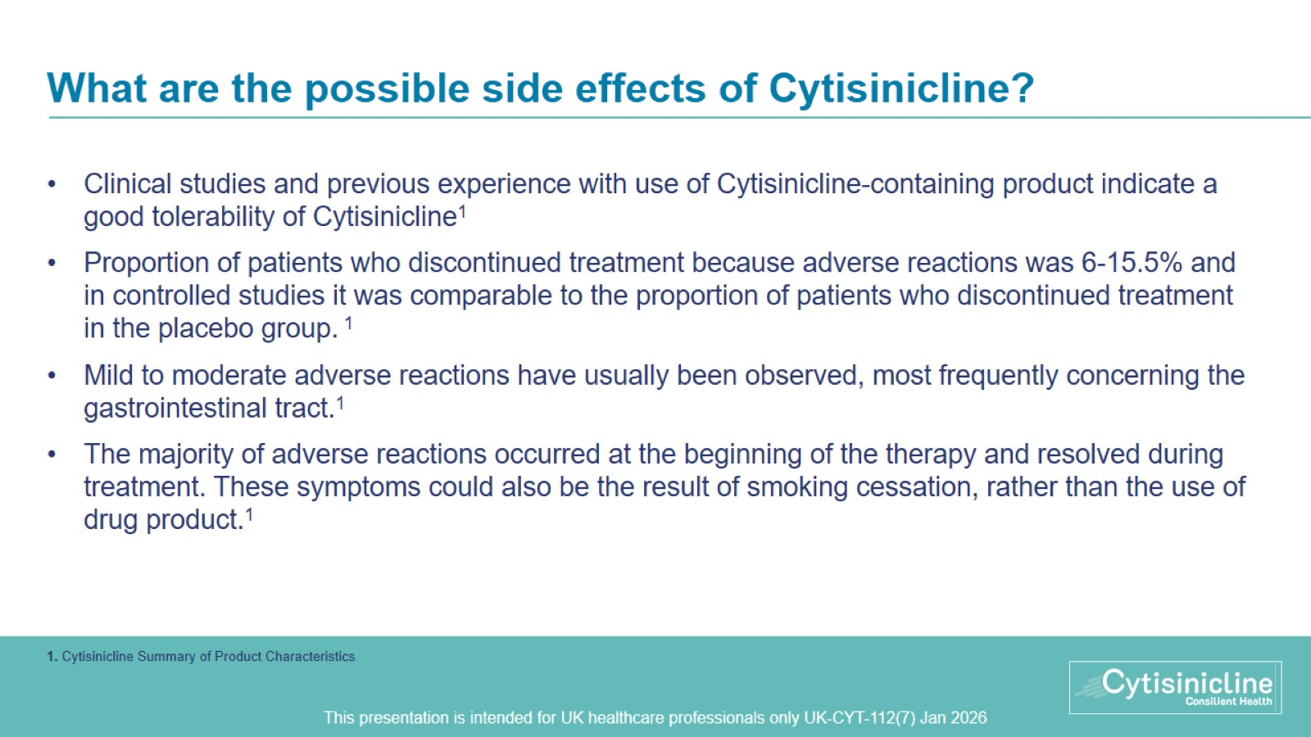
What are the possible side effects of Cytisinicline?
Notes:
4.8 Undesirable effects
The clinical studies and previous experience with use of cytisine-containing product indicate a good tolerability of Cytisinicline. The proportion of patients who discontinued treatment because adverse reactions was 6-15,5% and in controlled studies it was comparable to the proportion of patients who discontinued treatment in the placebo group. Mild to moderate adverse reactions have usually been observed, most frequently concerning the gastrointestinal tract. The majority of adverse reactions occurred at the beginning of the therapy and resolved during treatment. These symptoms could also be the result of smoking cessation, rather than the use of drug product.

Slide 17
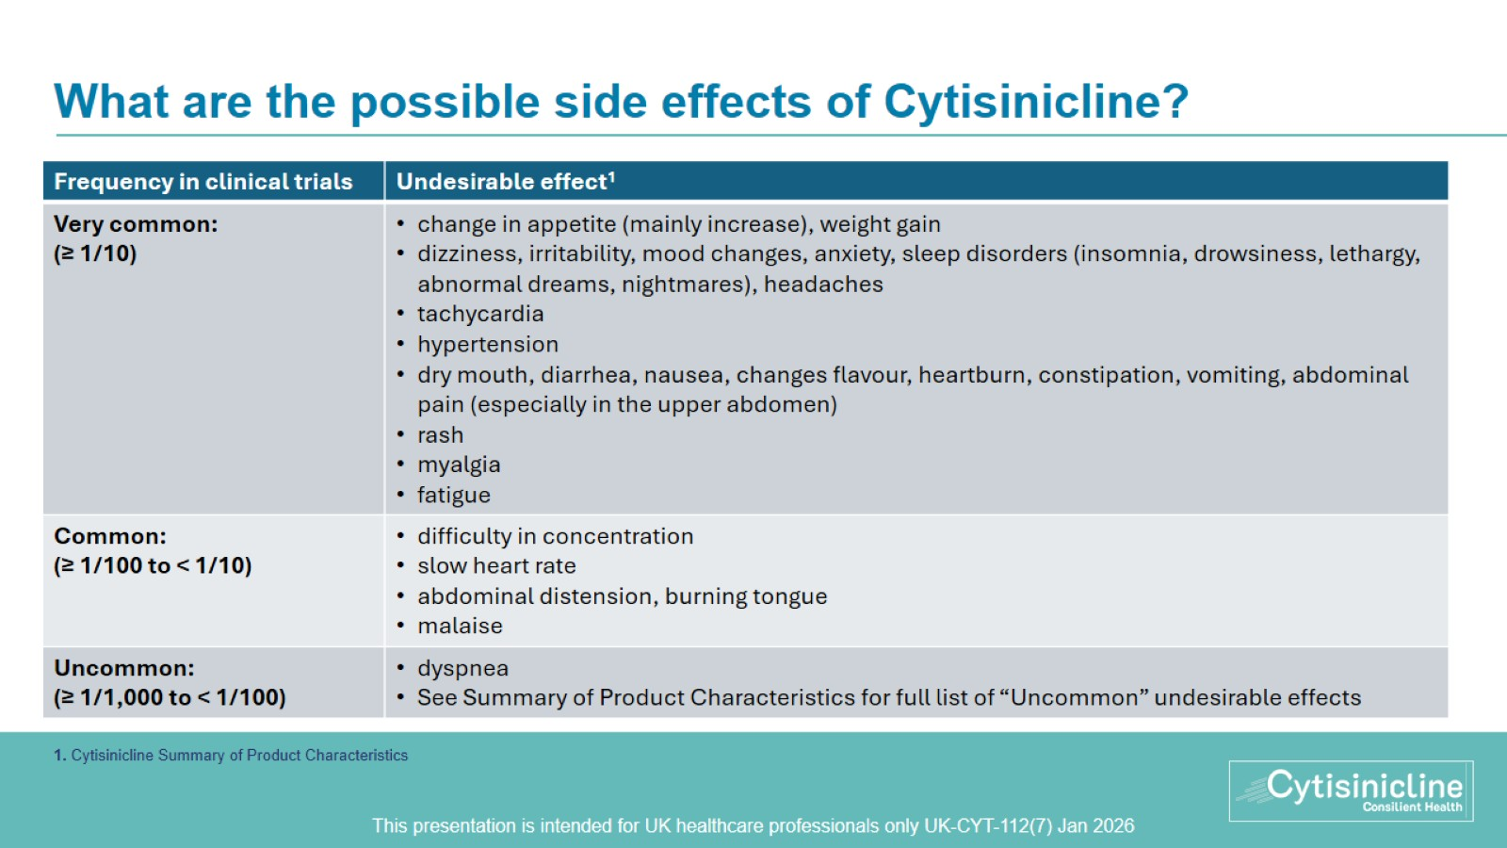
What are the possible side effects of Cytisinicline?
Notes:
4.8 Undesirable effects
All adverse reactions by system organ class and frequency of occurrence in clinical trials are listed below. The frequency of occurrence is defined as follows: very common (≥ 1/10), common (≥ 1/100 to < 1/10), uncommon (≥ 1/1,000 to < 1/100), rare (≥ 1/10,000 to < 1/1,000), very rare (<1/10,000), not known (cannot be estimated from the available data).
Metabolism and nutrition disorders: very common: change in appetite (mainly increase), weight gain
Nervous system disorders: very common: dizziness, irritability, mood changes, anxiety, sleep disorders (insomnia, drowsiness, lethargy, abnormal dreams, nightmares), headaches. Common: difficulty in concentration. Uncommon: feeling of heaviness in the head, decreased libido
Eye disorders: uncommon: lacrimation
Cardiac disorders: very common: tachycardia. Common: slow heart rate
Vascular disorders: very common: hypertension
Respiratory, thoracic and mediastinal disorders: uncommon: dyspnea, increased sputum
Gastrointestinal disorders: very common: dry mouth, diarrhea, nausea, changes flavour, heartburn, constipation, vomiting, abdominal pain (especially in the upper abdomen). Common: abdominal distension, burning tongue. Uncommon: excessive salivation.
Skin and subcutaneous tissue disorders: very common: rash. Uncommon: sweating, decreased elasticity of the skin
Musculoskeletal and connective tissue disorders: very common: myalgia
General disorders and administration site conditions: very common: fatigue. Common: malaise. Uncommon: tiredness
Investigations: uncommon: increase in serum transaminase levels

Slide 18
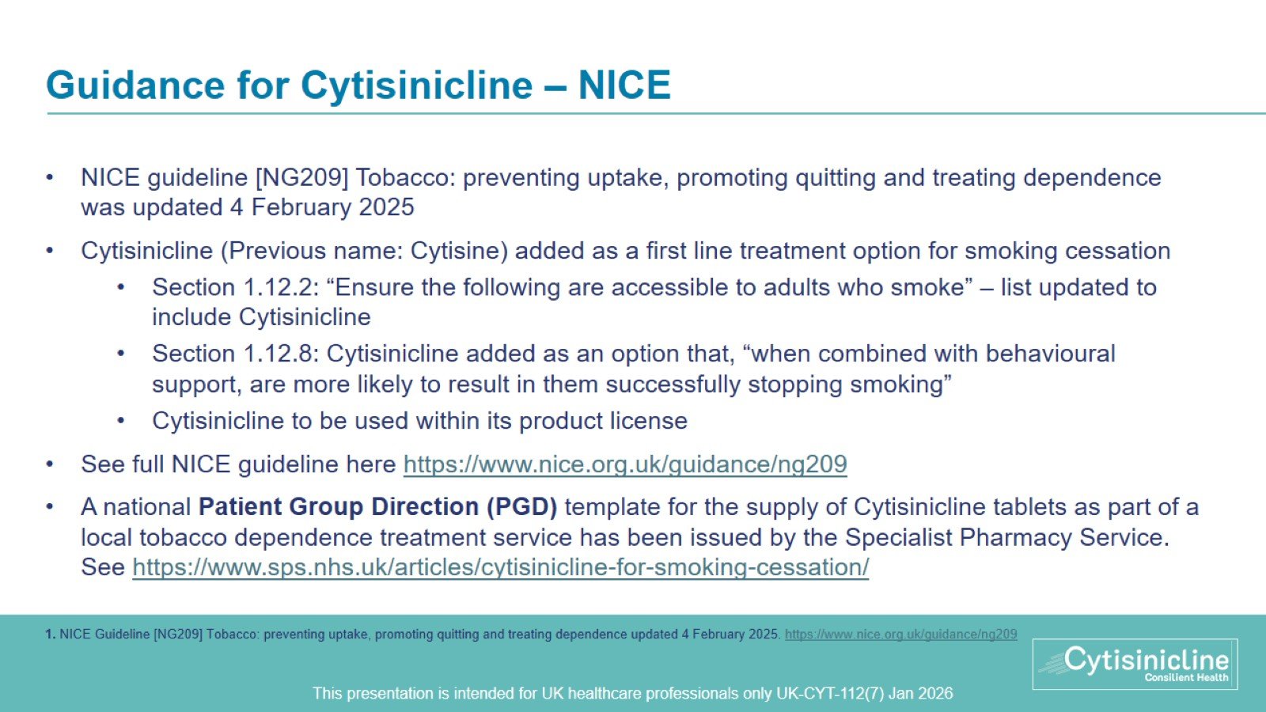
Guidance for Cytisinicline – NICE

Slide 19
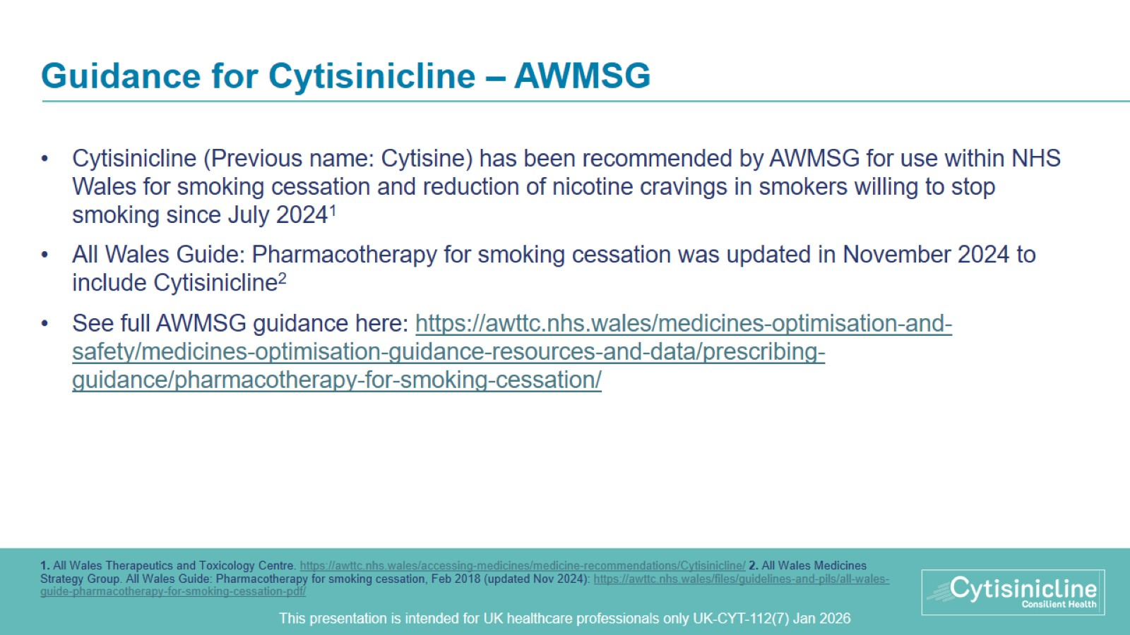
Guidance for Cytisinicline – AWMSG

Slide 20
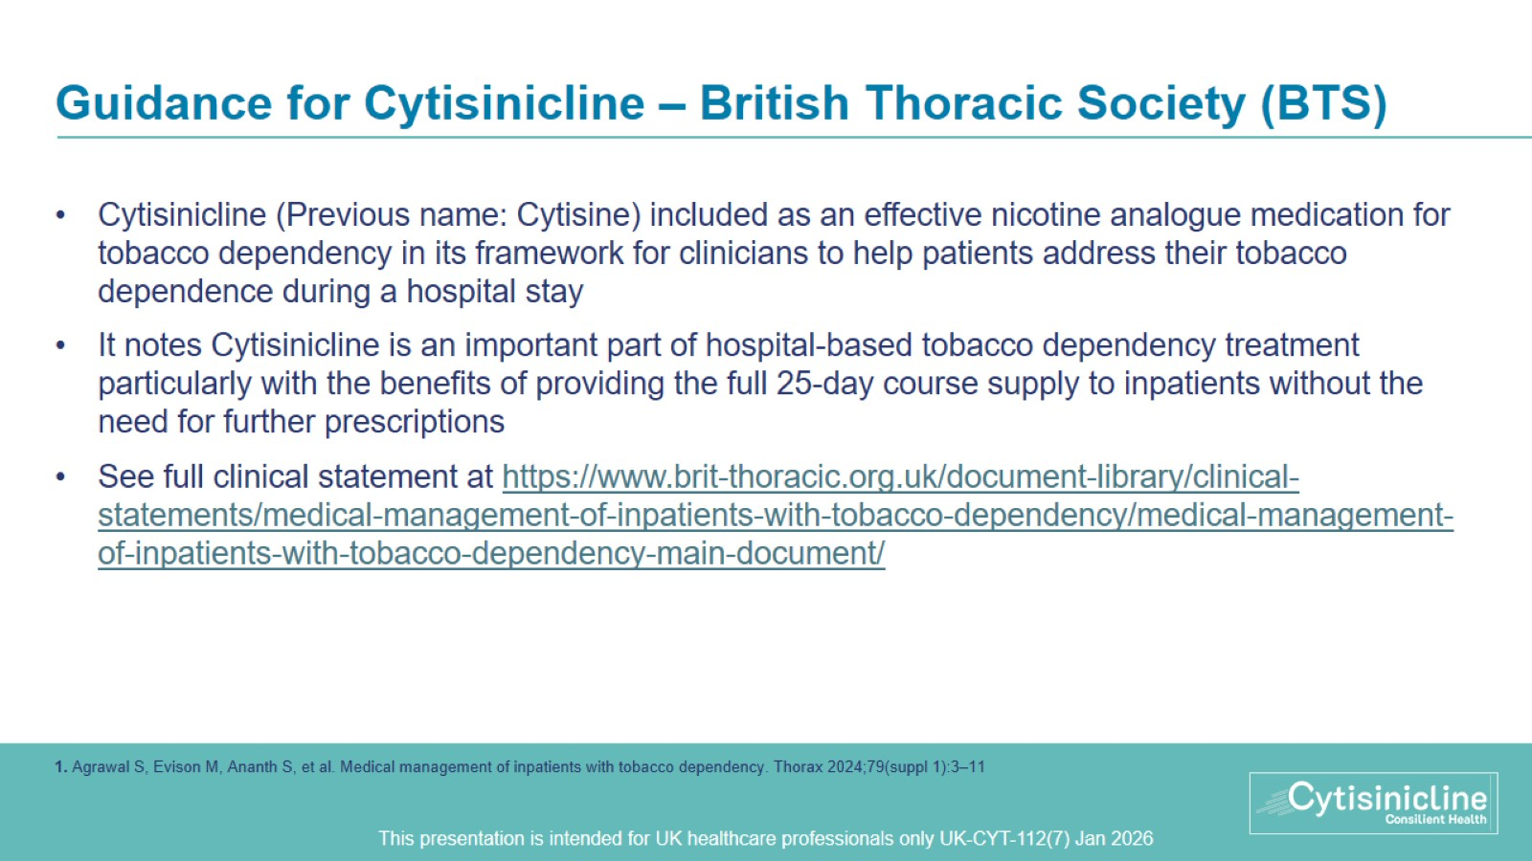
Guidance for Cytisinicline – British Thoracic Society (BTS)

Slide 21
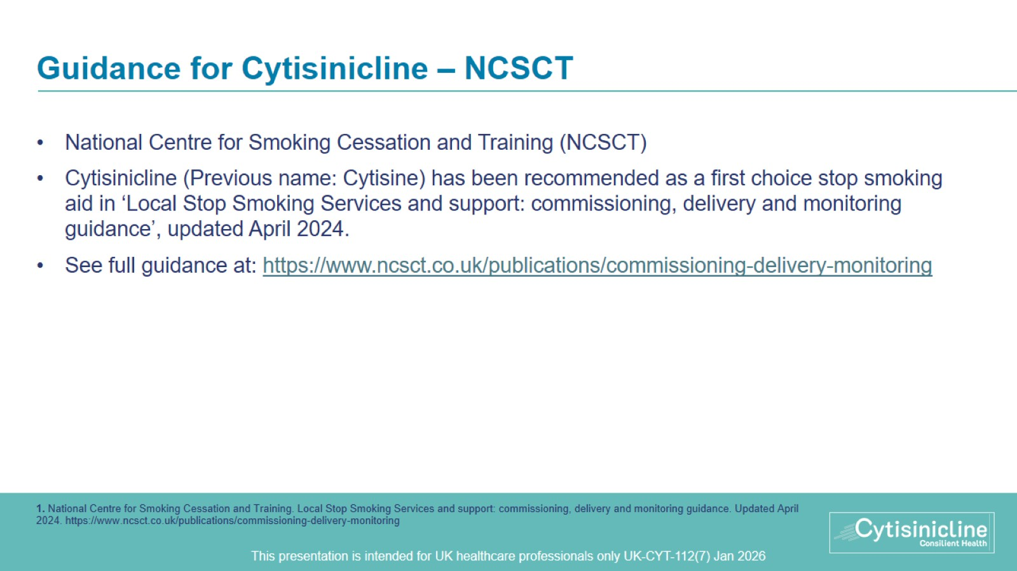
Guidance for Cytisinicline – NCSCT

Slide 22
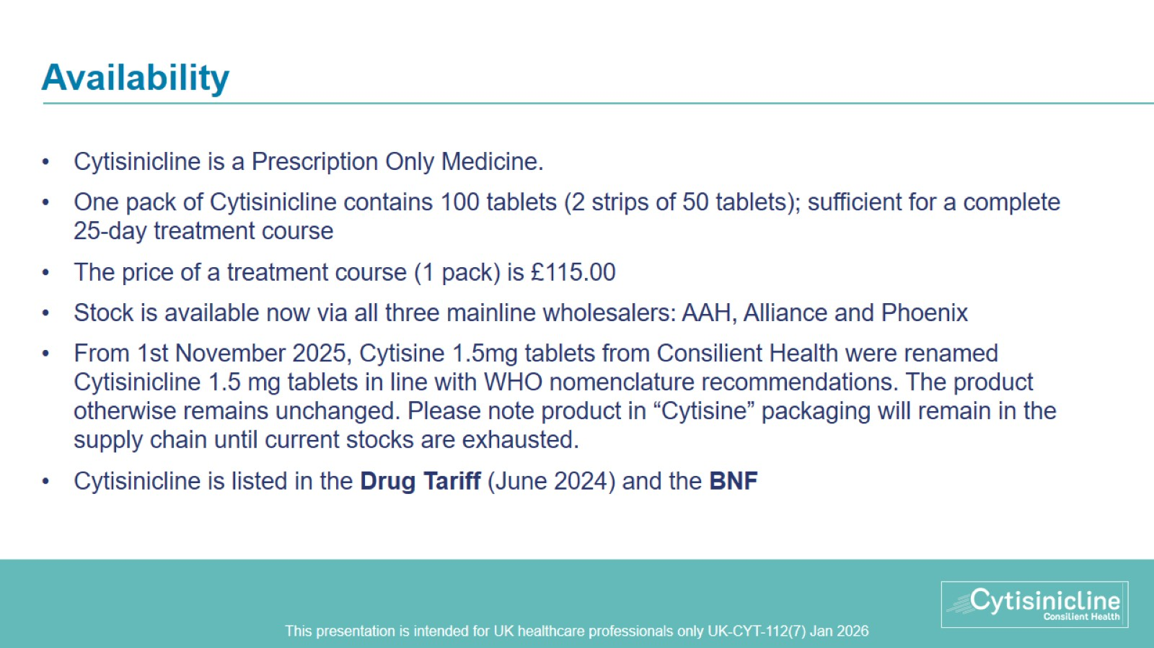
Availability

Slide 23
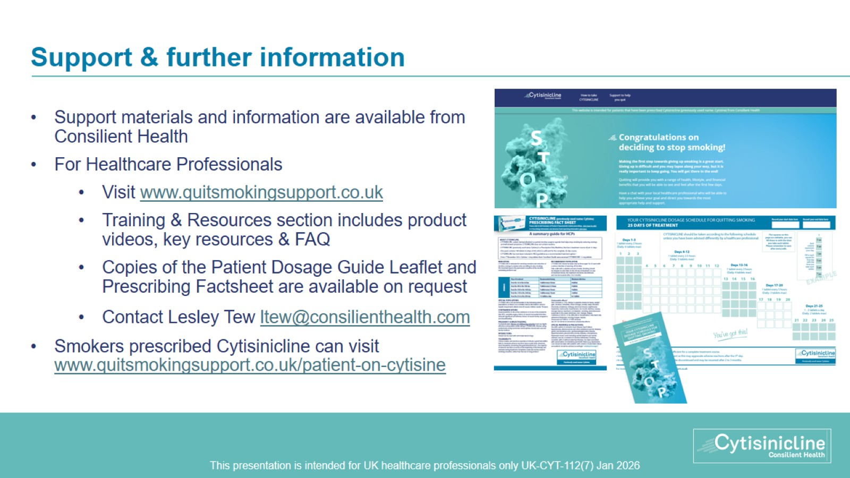
Support & further information

Slide 24
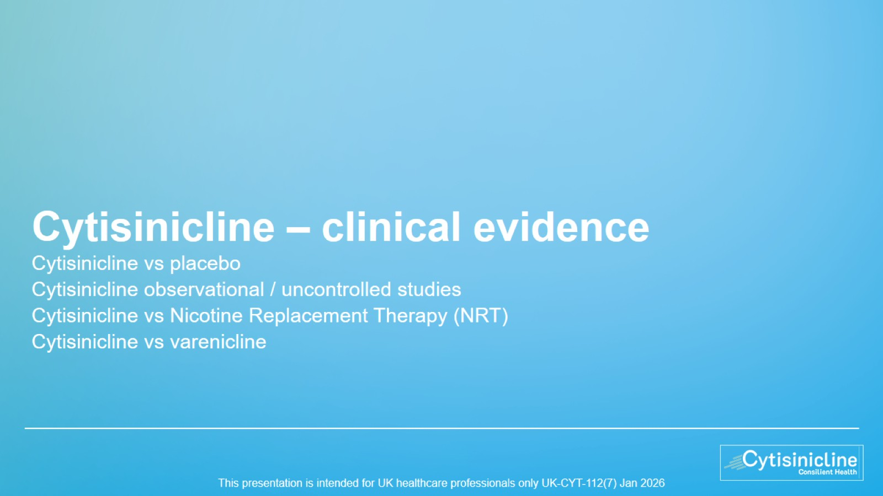
Cytisinicline – clinical evidence

Slide 25
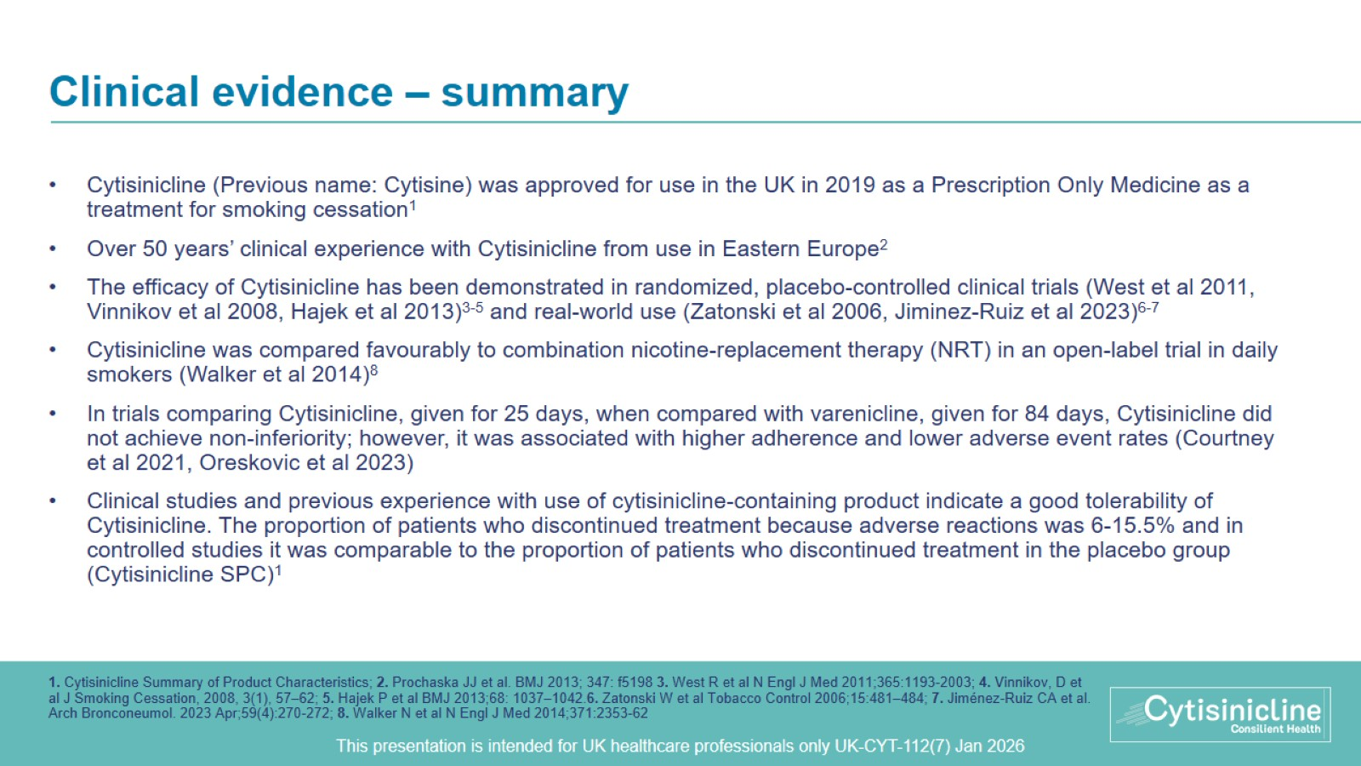
Clinical evidence – summary

Slide 26
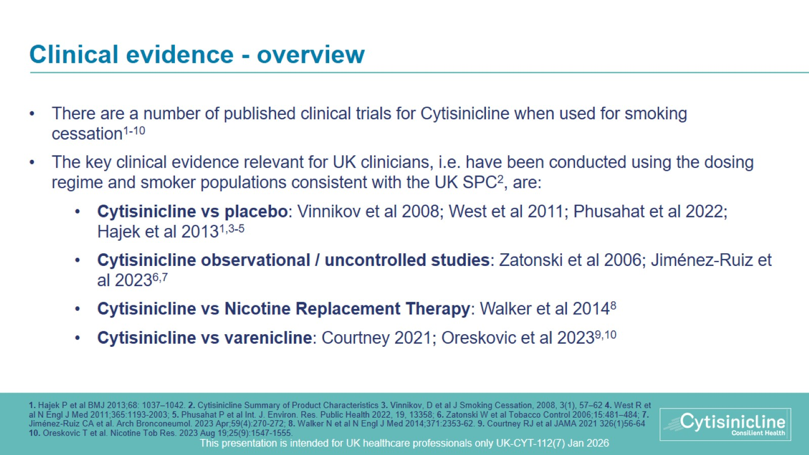
Clinical evidence - overview

Slide 27
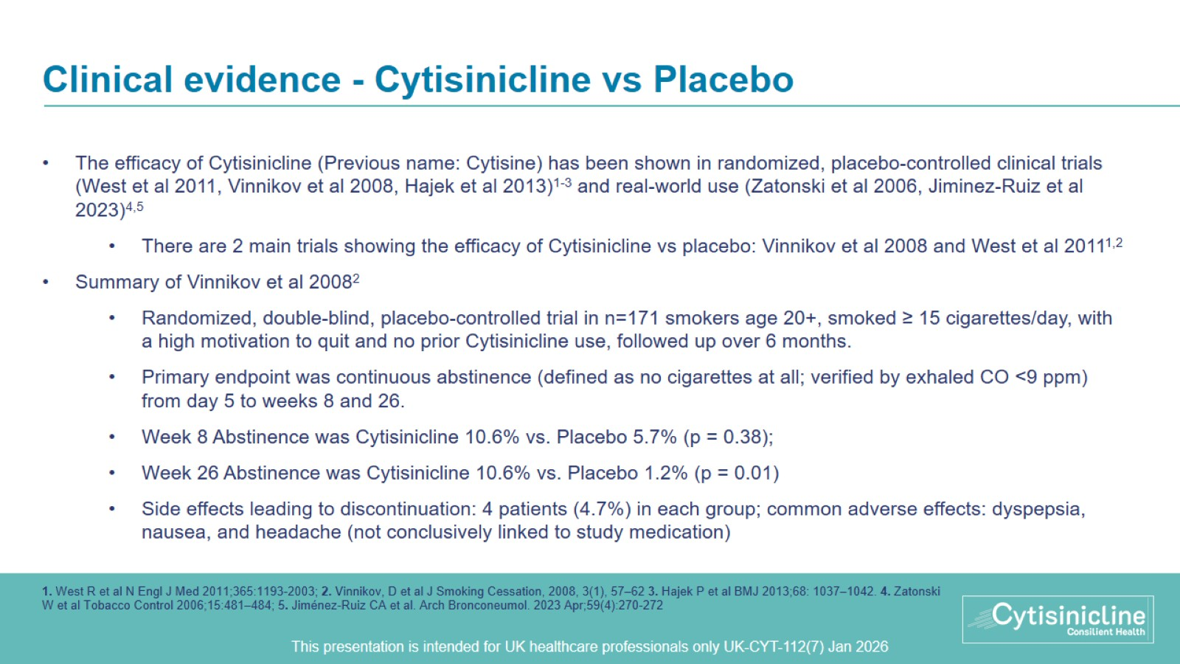
Clinical evidence - Cytisinicline vs Placebo
Notes:
All patients were from the staff of the mining company in Kyrgyzstan, mainly men.
Exclusion criteria:
- Serious or unstable disorders based on annual screening data including chest X-ray, electrocardiogram, cardiac ultrasonography upon indications, lung function testing, blood cell count, and blood biochemical assay.
- Contra-indications for Cytisinicline

Slide 28
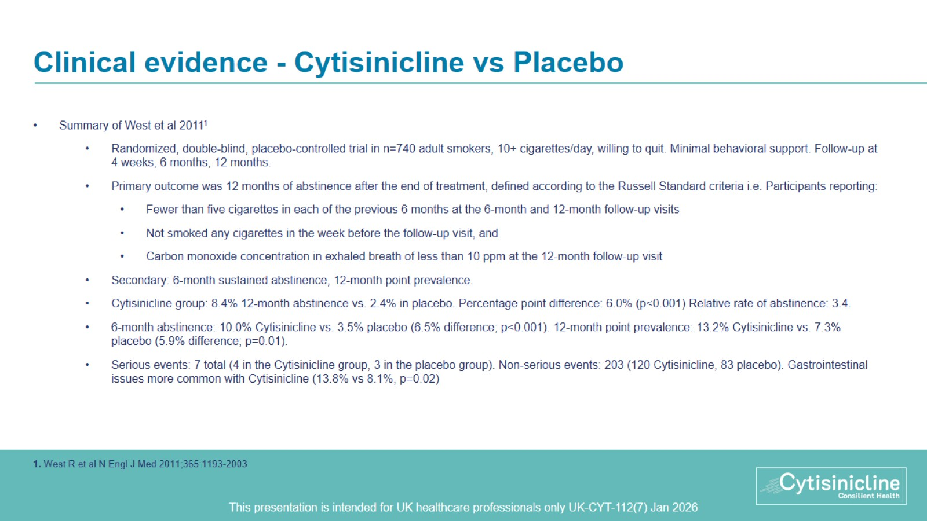
Clinical evidence - Cytisinicline vs Placebo
Notes:
Other inclusion criteria: not pregnant or breast-feeding or planning to become pregnant; willing to attend all study sessions; able to read and write Polish and provide informed consent; and could be contacted by telephone
Exclusion criteria: diagnosis of a current psychiatric disorder or a medical condition that was a Cytisinicline contraindication

Slide 29
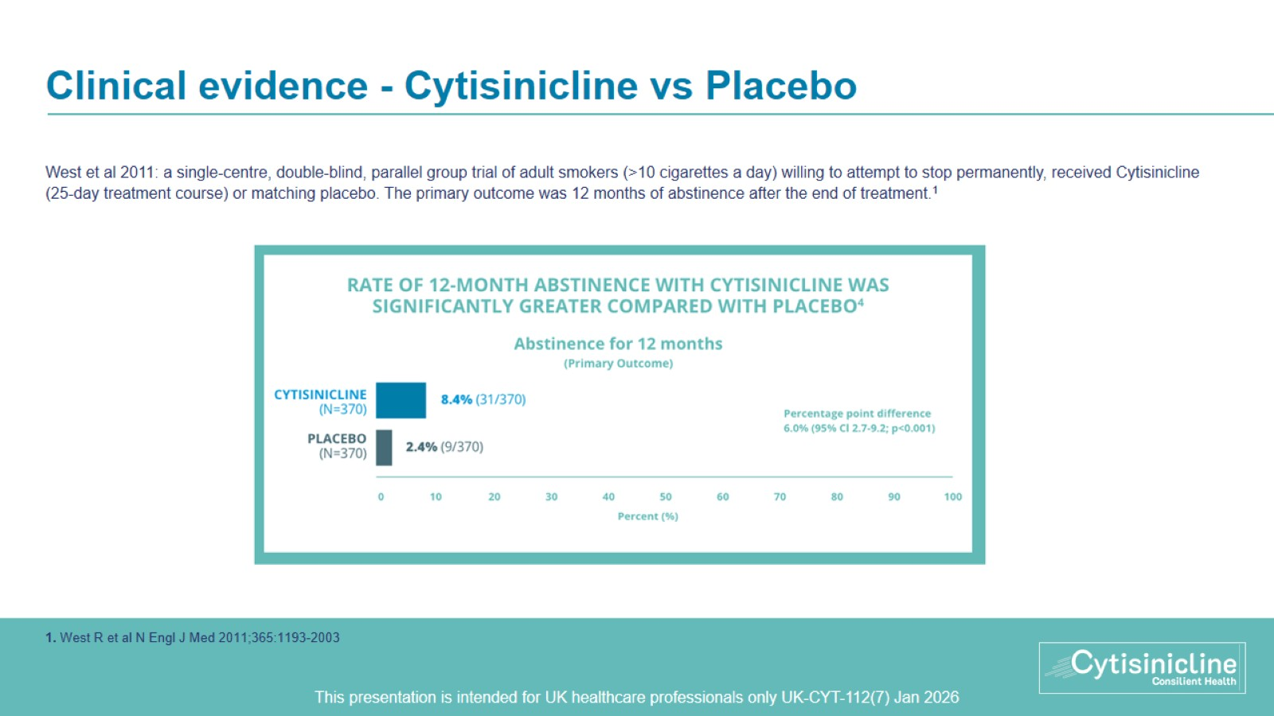
Clinical evidence - Cytisinicline vs Placebo

Slide 30
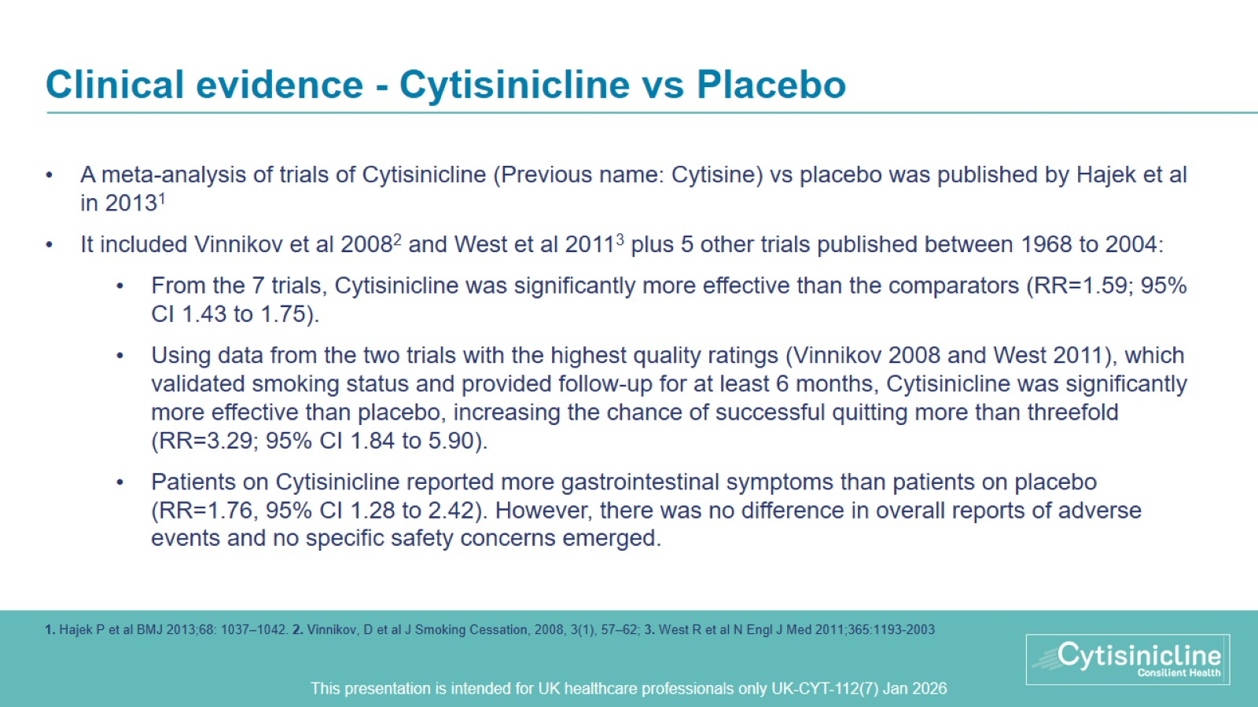
Clinical evidence - Cytisinicline vs Placebo

Slide 31
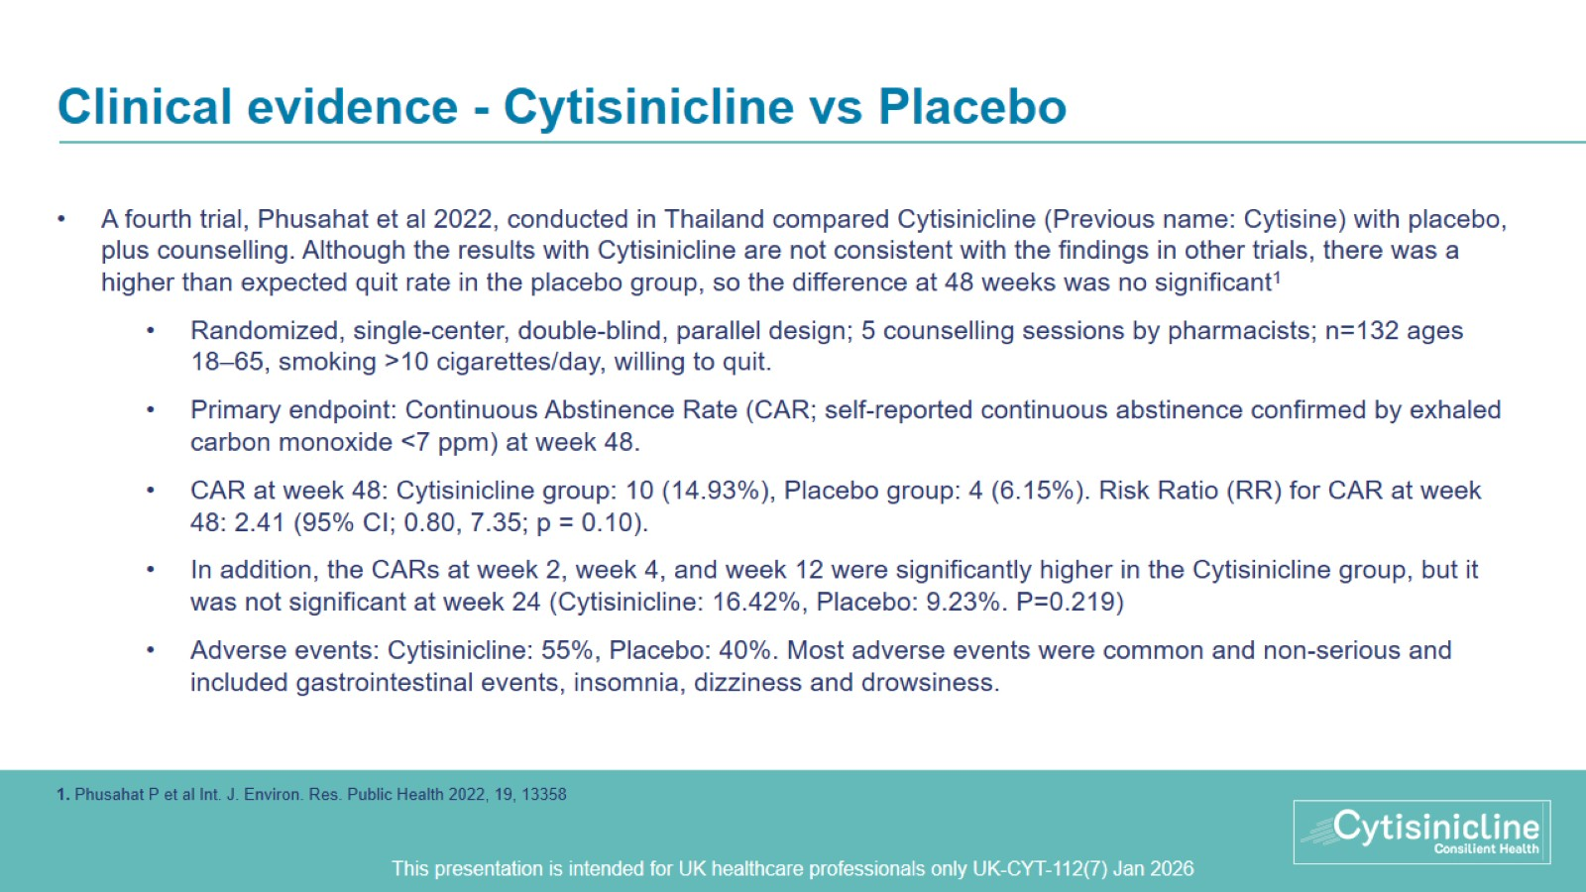
Clinical evidence - Cytisinicline vs Placebo
Notes:
Exclusion criteria: cardiac arrhythmia, cardiovascular disease, cancer, chronic renal disease (eGFR ≤ 30 mL/min/1.73 m2), psychiatric disorders (depression, schizophrenia, or using other drugs, such as marijuana and amphetamines), pregnancy, breast-feeding, or treatment with other smoking cessation medications. Female participants of reproductive age were required to have a contraception before and during the study.

Slide 32
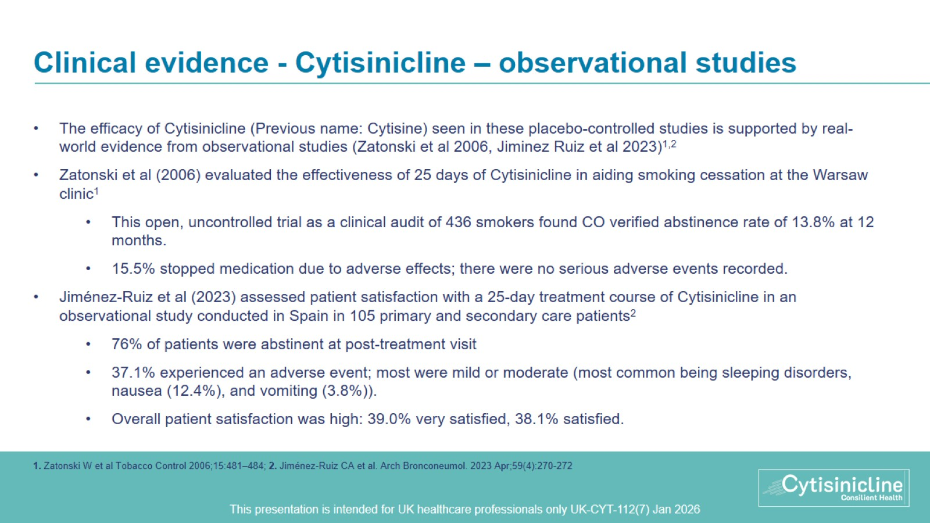
Clinical evidence - Cytisinicline – observational studies

Slide 33
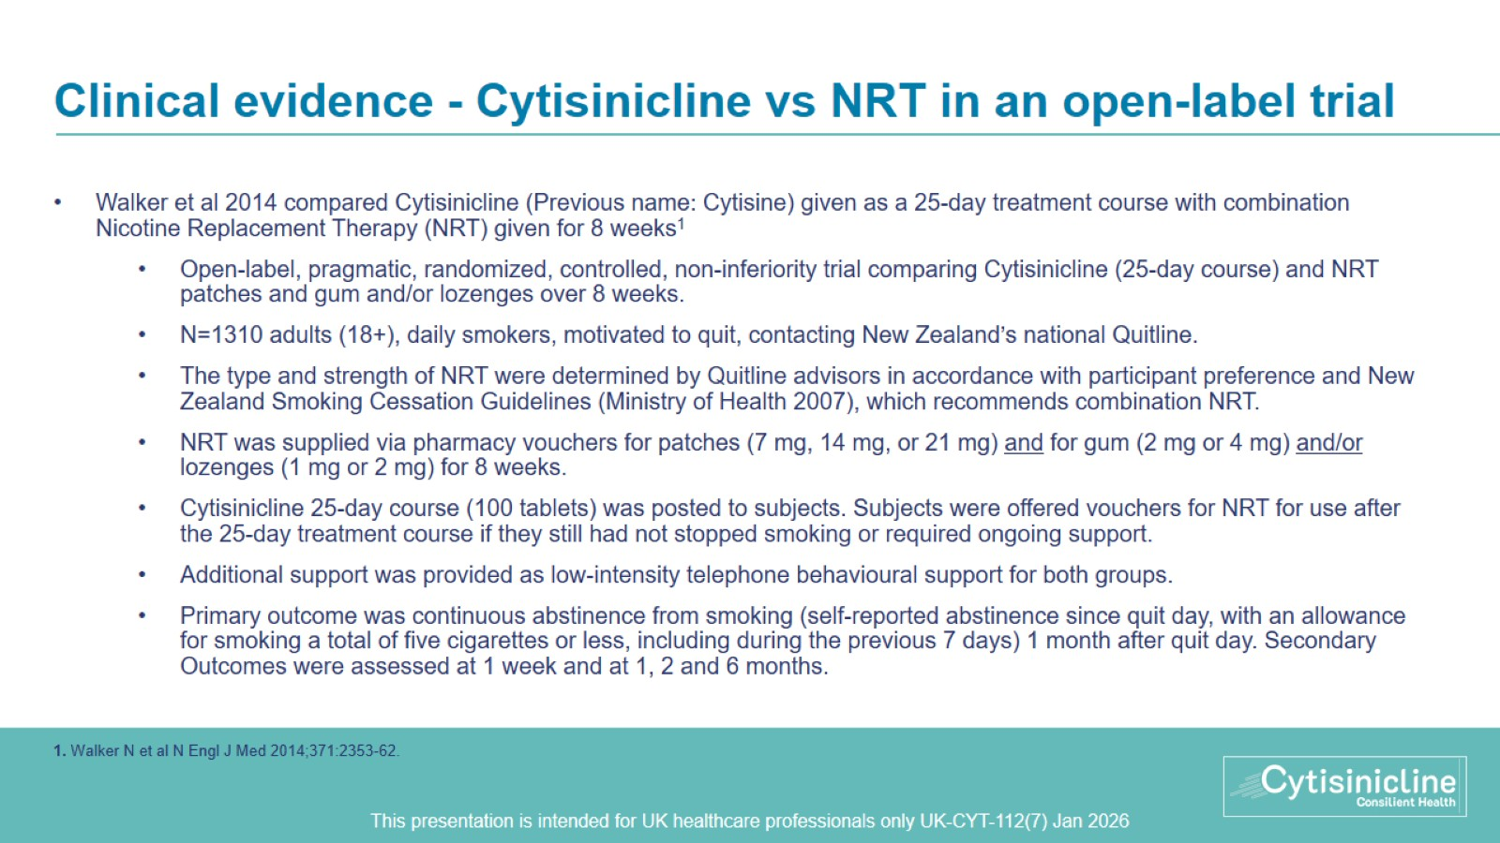
Clinical evidence - Cytisinicline vs NRT in an open-label trial
Notes:
Exclusion criteria: pregnant or breast-feeding, taking smoking cessation medication, enrolled in another cessation program or study; self-reported pheochromocytoma; systolic blood pressure above 150 mm Hg, a diastolic blood pressure above 100 mm Hg, or both; schizophrenia, or self-reported cardiovascular event in the 2 weeks before study enrolment.

Slide 34
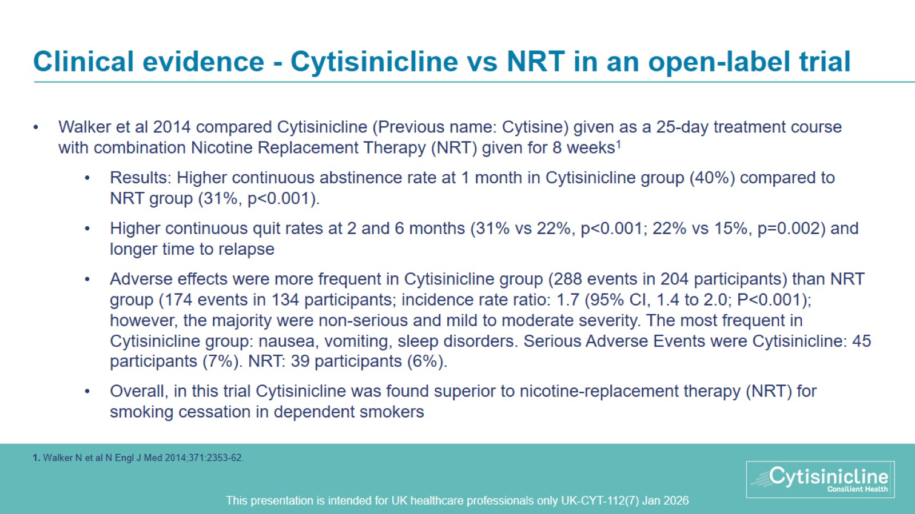
Clinical evidence - Cytisinicline vs NRT in an open-label trial

Slide 35
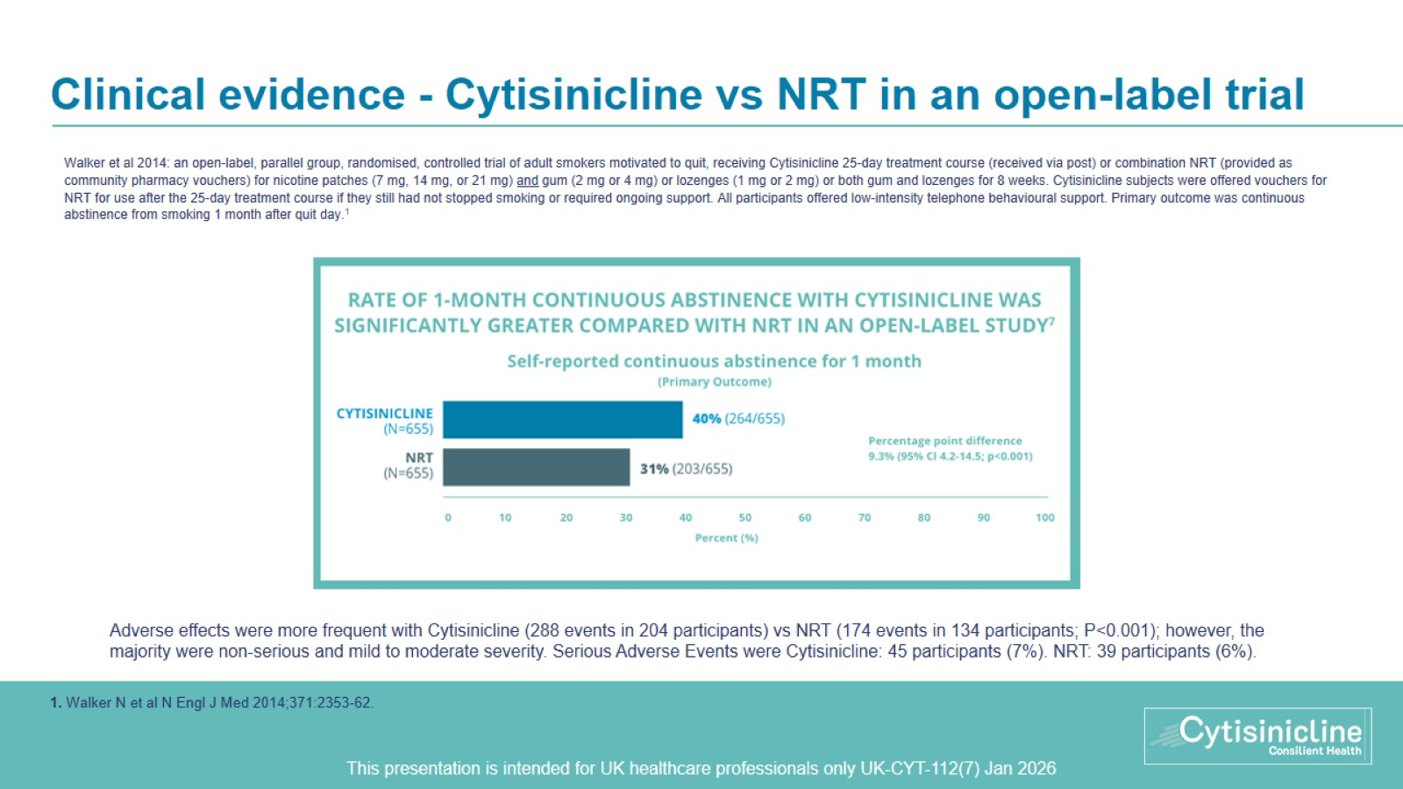
Clinical evidence - Cytisinicline vs NRT in an open-label trial

Slide 36
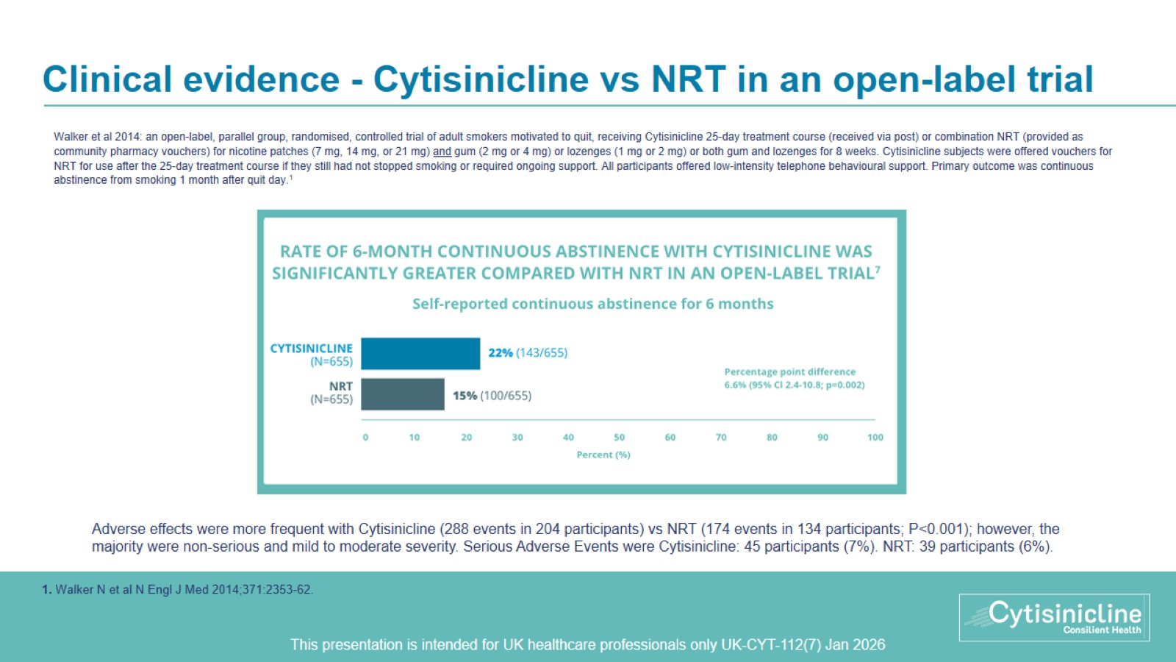
Clinical evidence - Cytisinicline vs NRT in an open-label trial

Slide 37
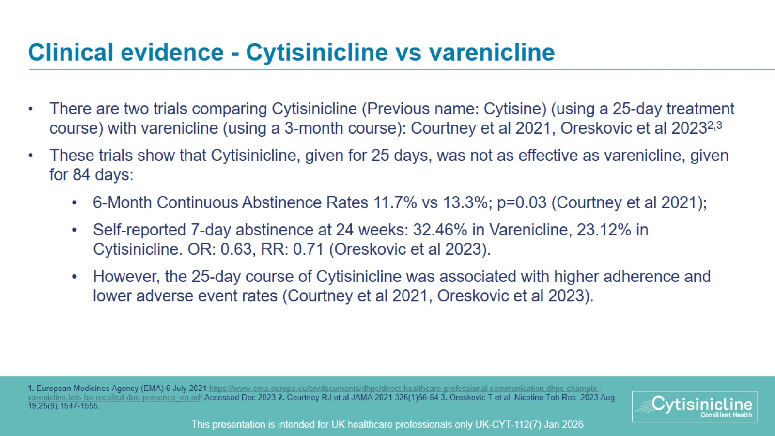
Clinical evidence - Cytisinicline vs varenicline

Slide 38
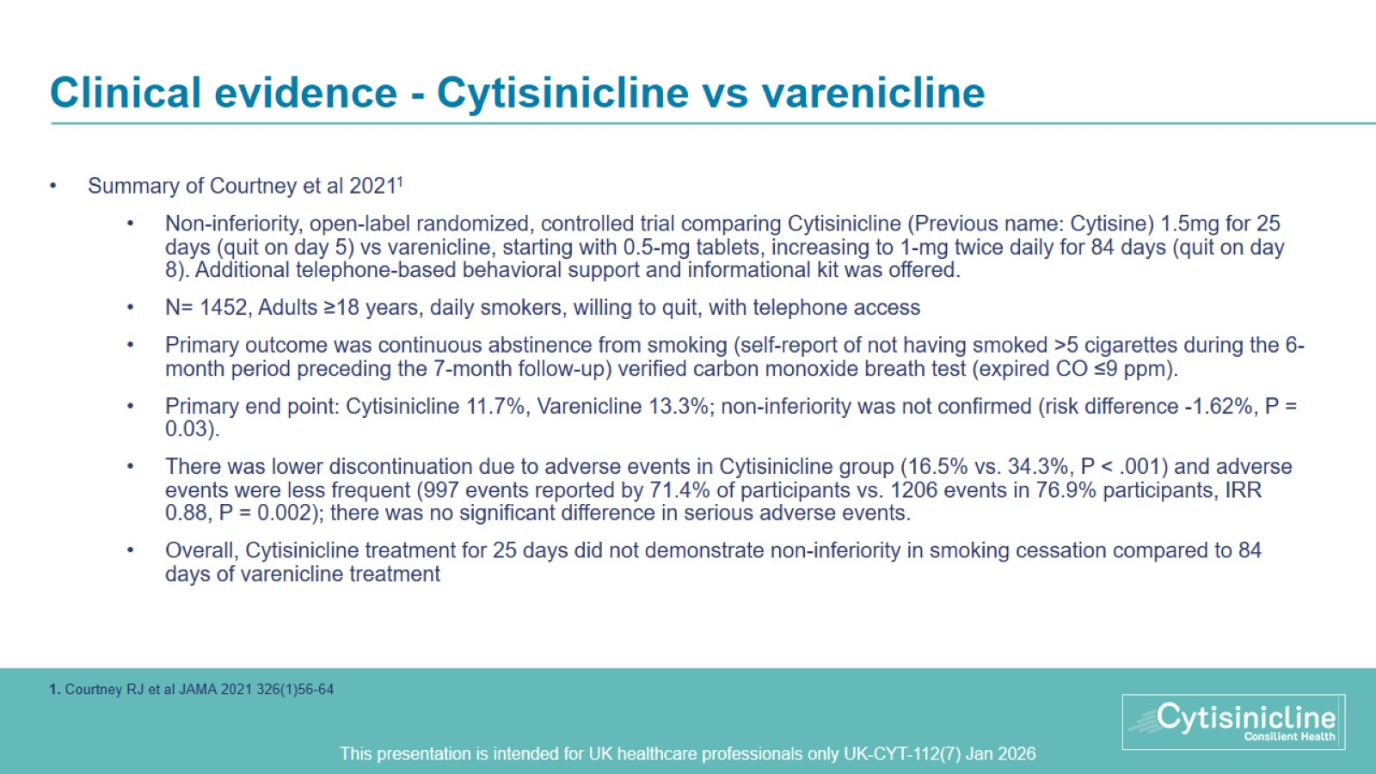
Clinical evidence - Cytisinicline vs varenicline
Notes:
Exclusion criteria: pregnancy, breastfeeding, or planning to get pregnant within the next 7 months; current use of smoking cessation medications or in another smoking cessation program; hypersensitivity to active substances or excipients; hospitalization in previous 3 months for arrhythmia, myocardial infarction, stroke, or severe angina; or pheochromocytoma or hyperthyroidism

Slide 39
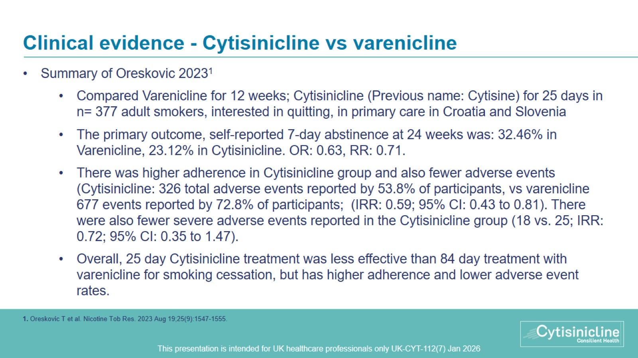
Clinical evidence - Cytisinicline vs varenicline
Notes:
Inclusion criteria: primary care MD at a participating practice; aged 18 or older; smoking at least one cigarette per day; a desire to quit; did not have contraindications (per SPCs); and indicated an interest in pharmacotherapy.
Exclusion criteria: cognitive impairment; a mental disorder; considered be insufficiently collaborative; considered by MDs to have frequent adverse reactions to multiple drugs in the previous treatment of acute and chronic diseases; pregnant or breastfeeding; and in another smoking-cessation program

Slide 40
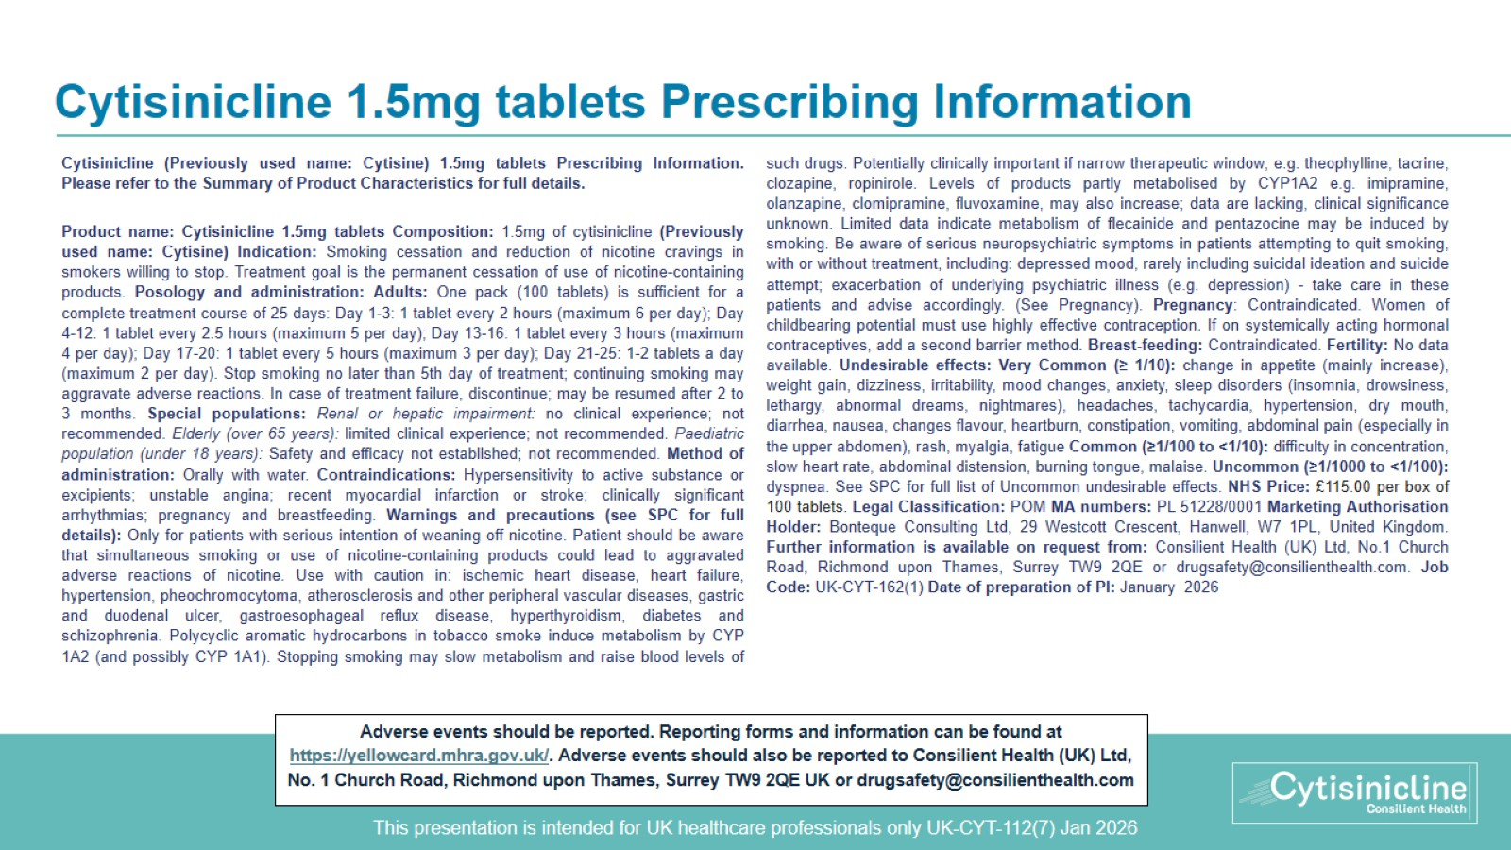
Cytisinicline 1.5mg tablets Prescribing Information

